Slide 1
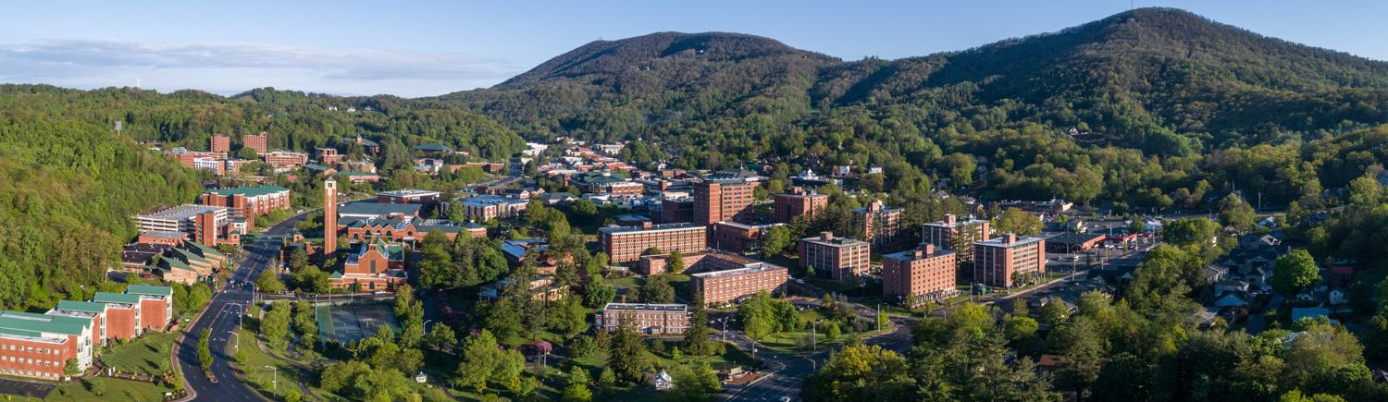
Community Resilience Forum January 2025

Slide 2
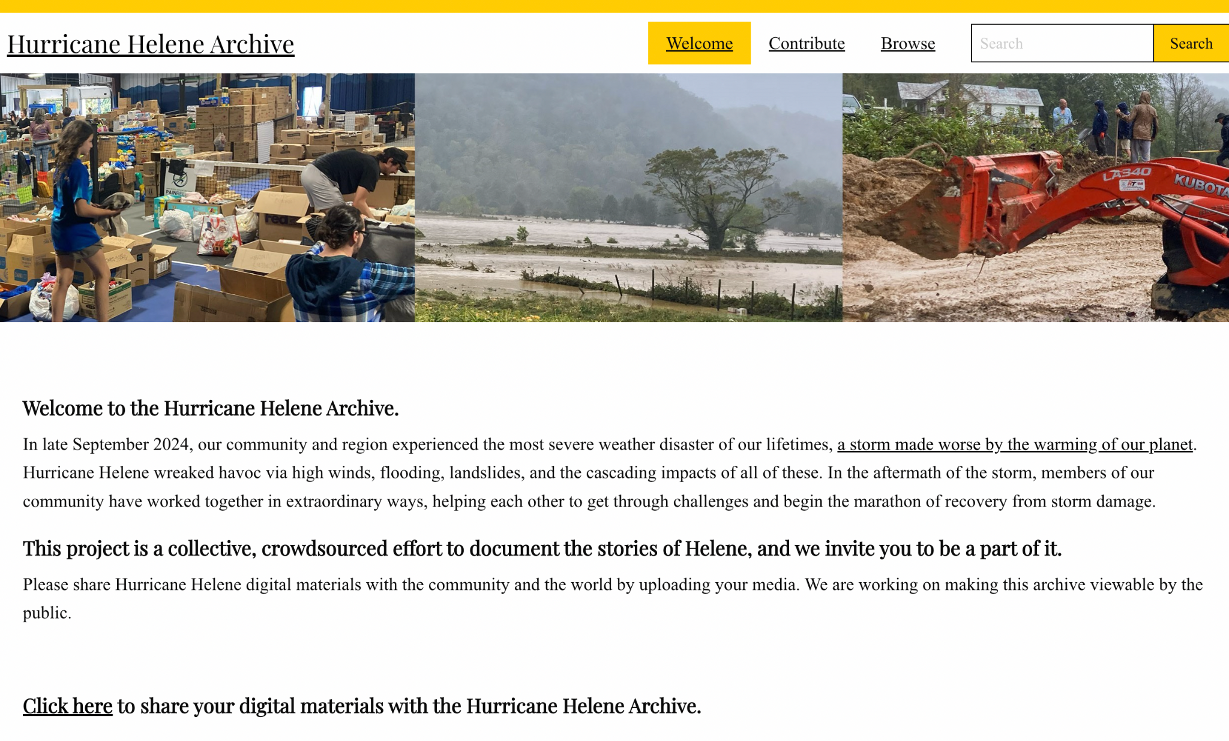
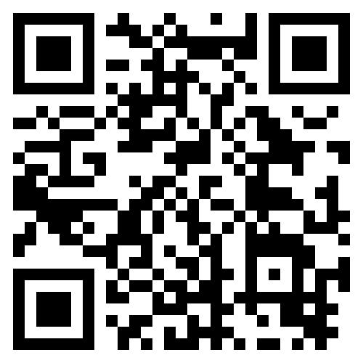
NEW: Hurricane Helene Archive

Slide 3
Liz Whiteman
Executive Director
Blue Ridge Women in Agriculture

Slide 4
Snapshot of Helene Damage in the Farm Community
35% of farms in the 21-county disaster area reported damage
Average of $37,000 for clean up and recovery per farm
Over $59 million in recovery costs for farms only region wide
Less than 4% of western North Carolina farms are covered by federal crop insurance programs
Source: Appalachian Sustainable Agriculture Project www.asapconnections.org

Slide 5
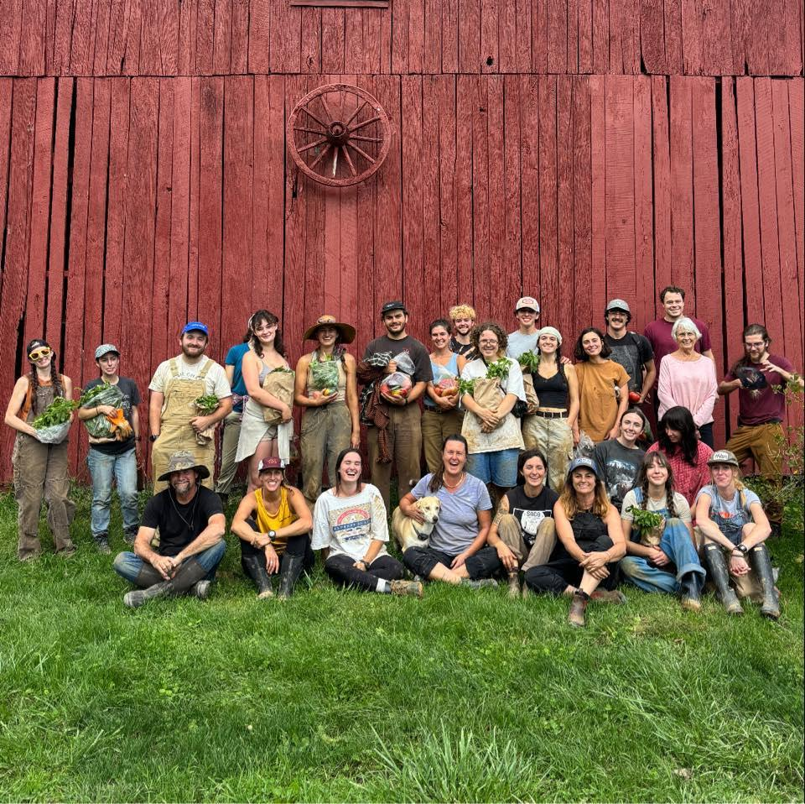
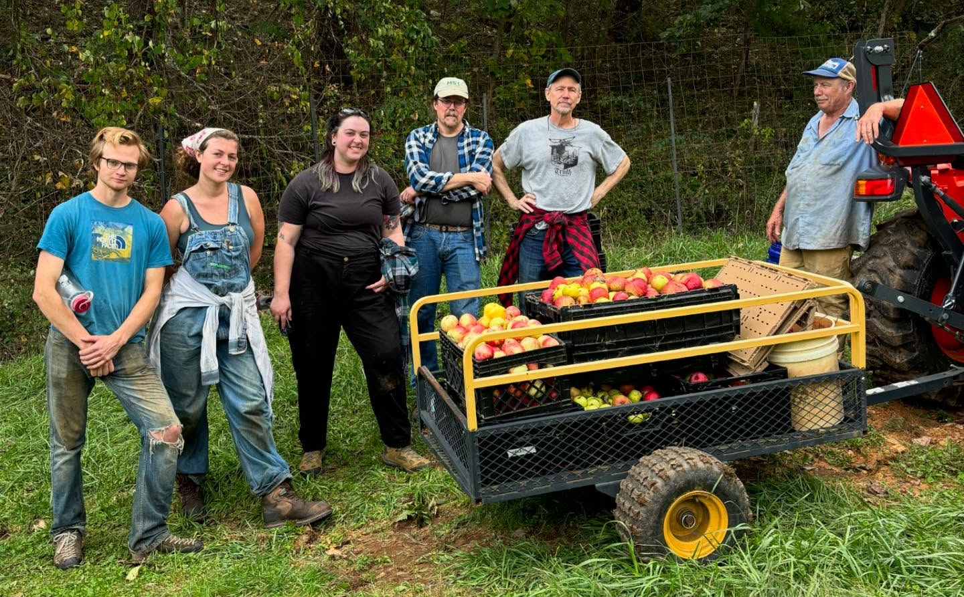
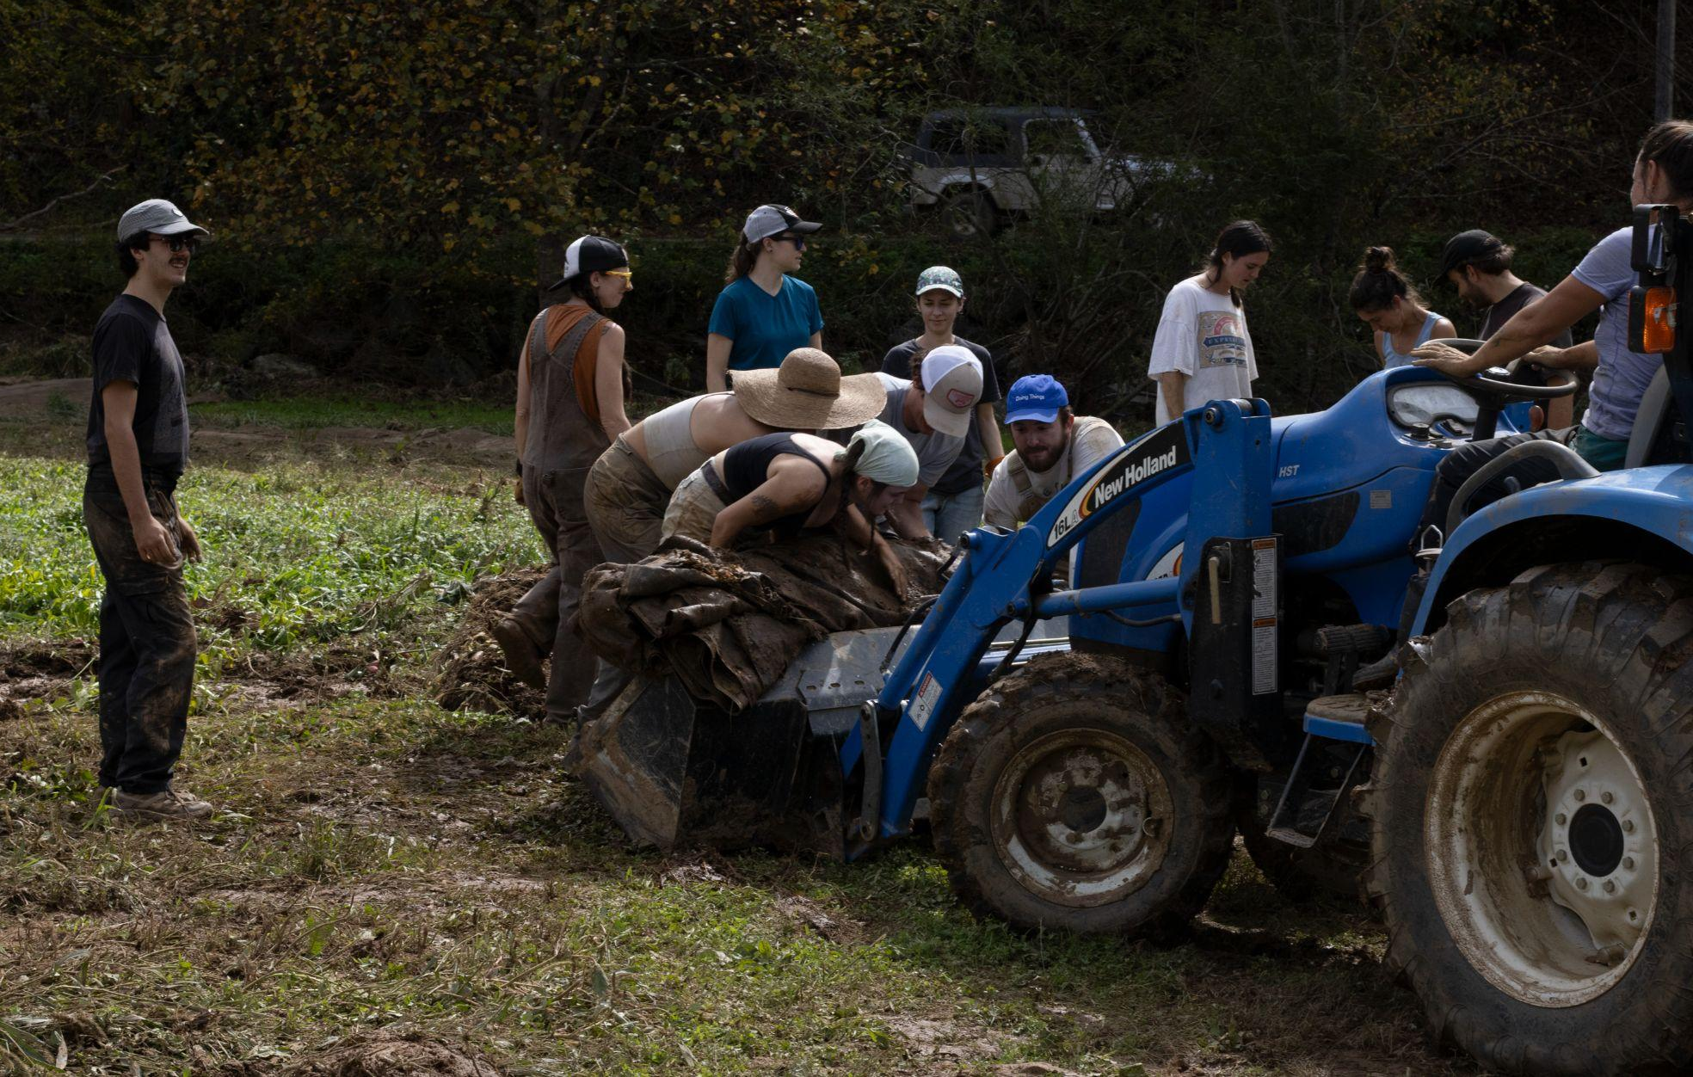

Slide 6
Andy Hill
High Country Regional Director and Watauga Riverkeeper
Mountain True

Slide 7
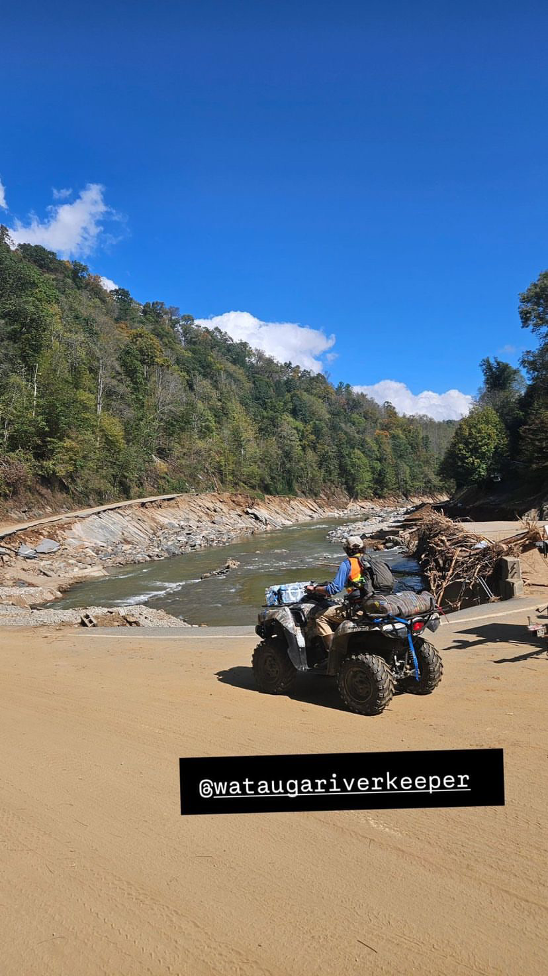
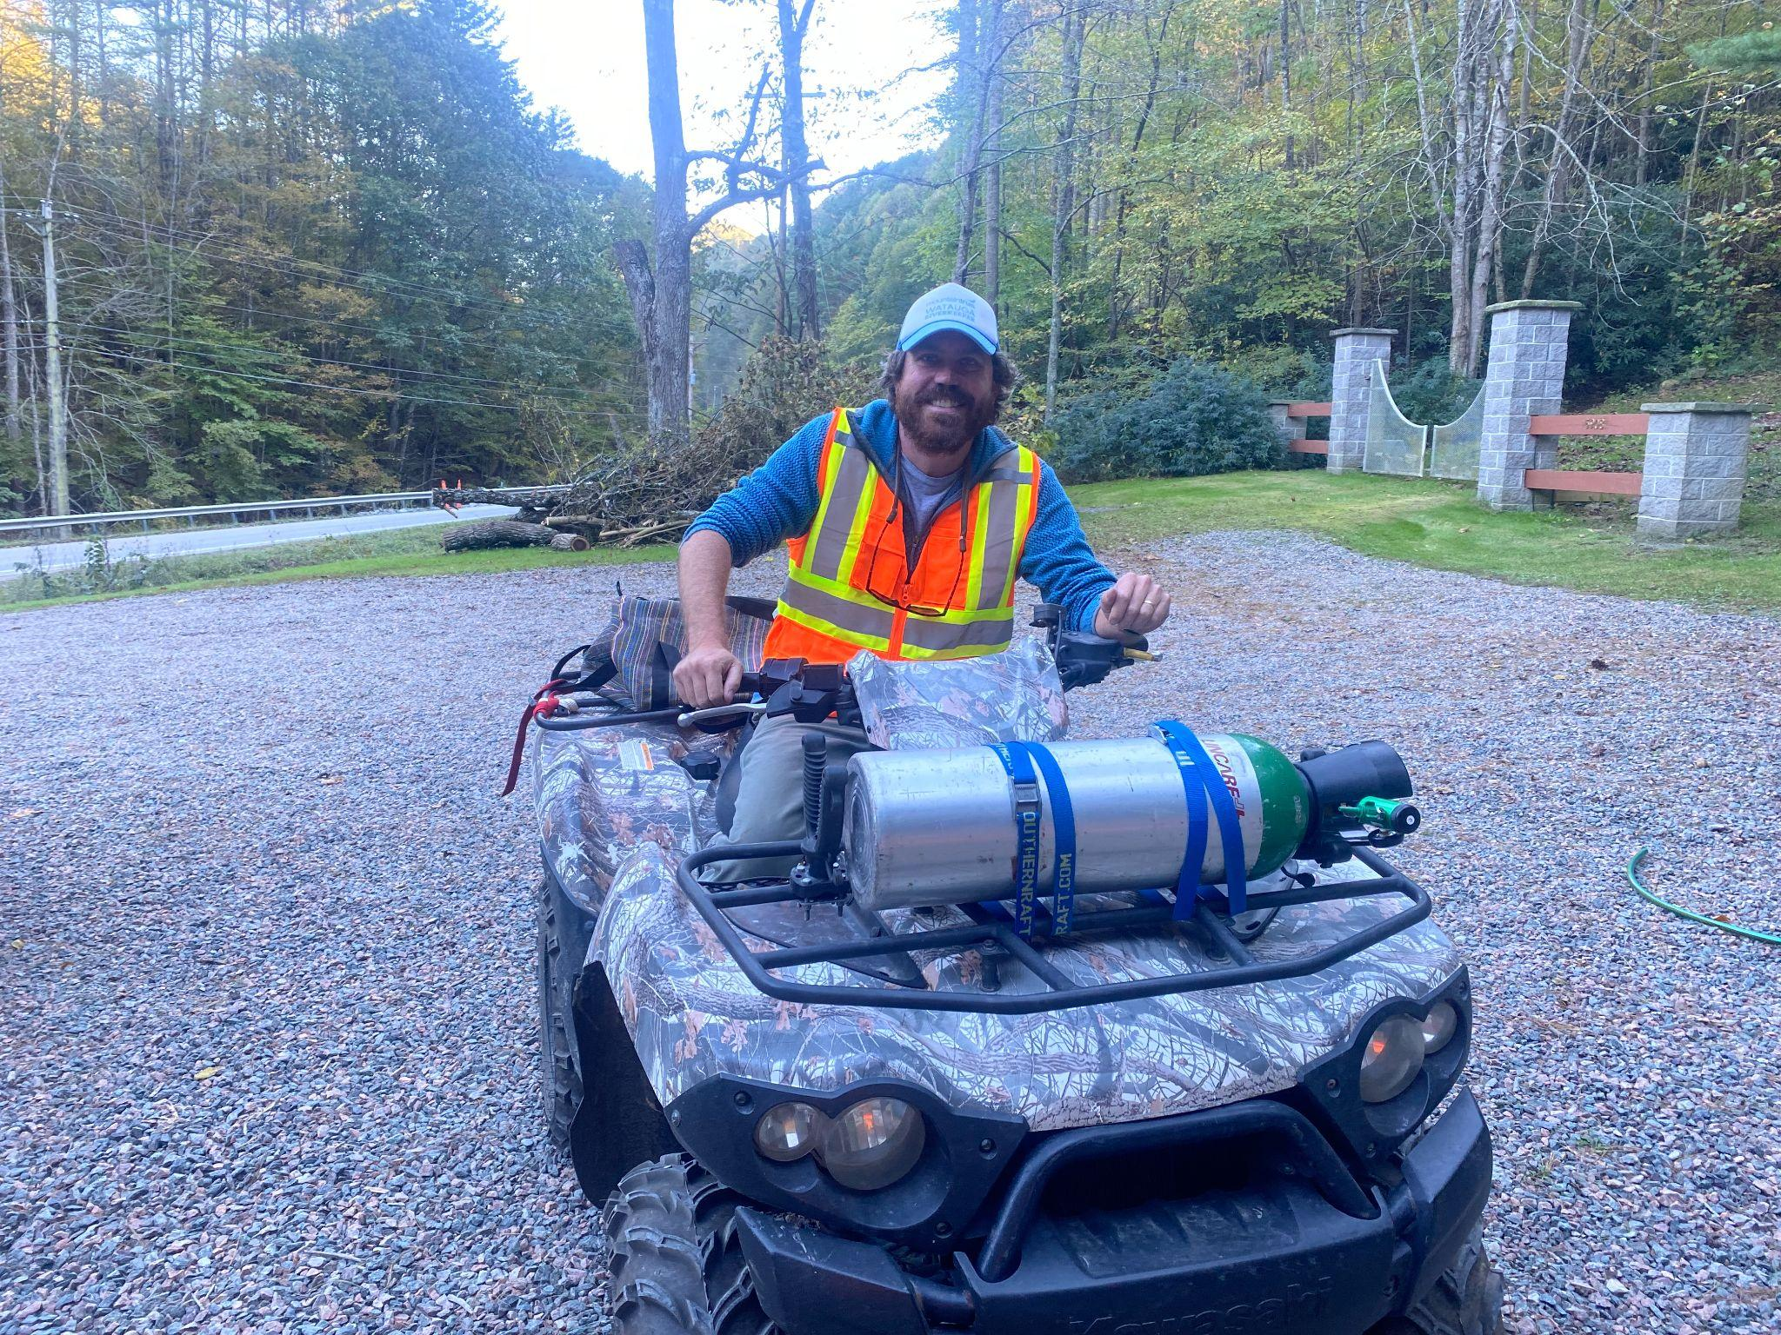
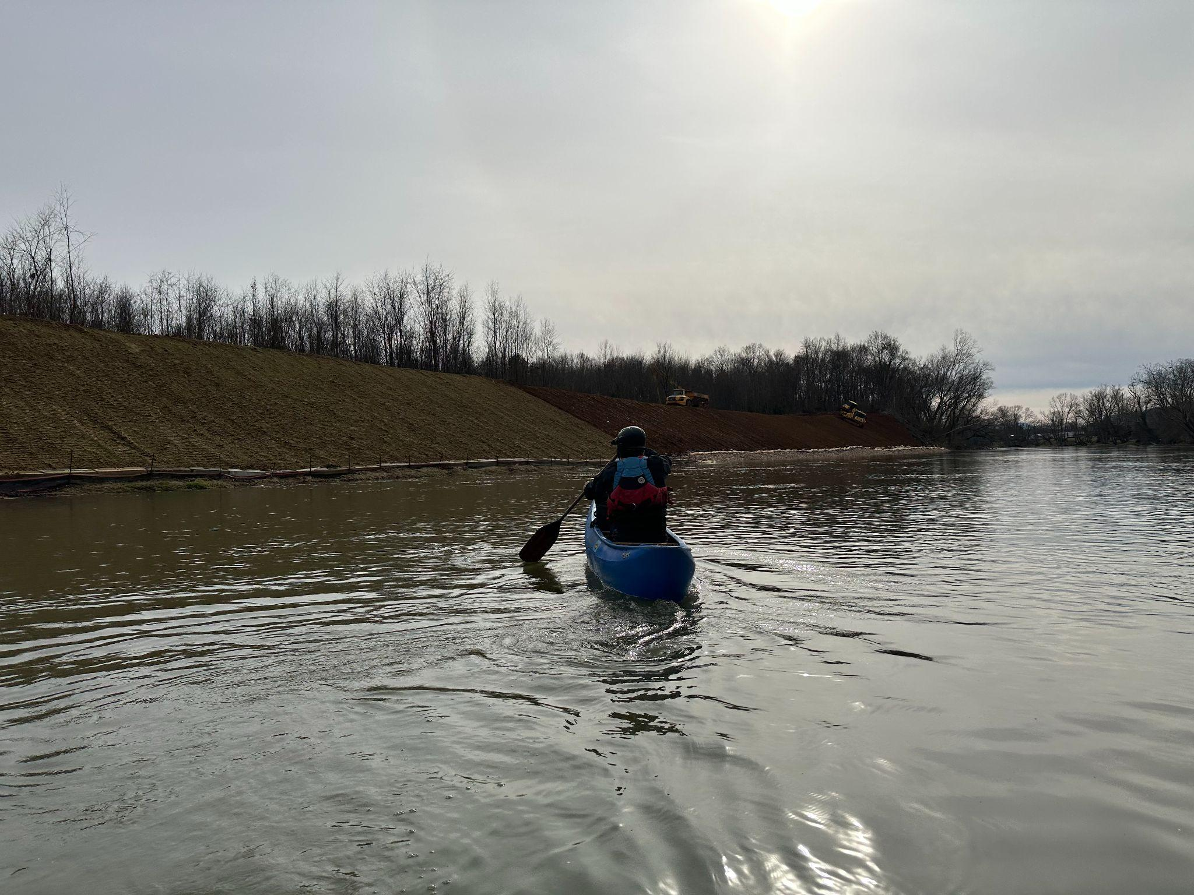
Early days of Helene response were focused on search and rescue, critical need delivery to isolated communities and assessing critical infrastructure

Slide 8
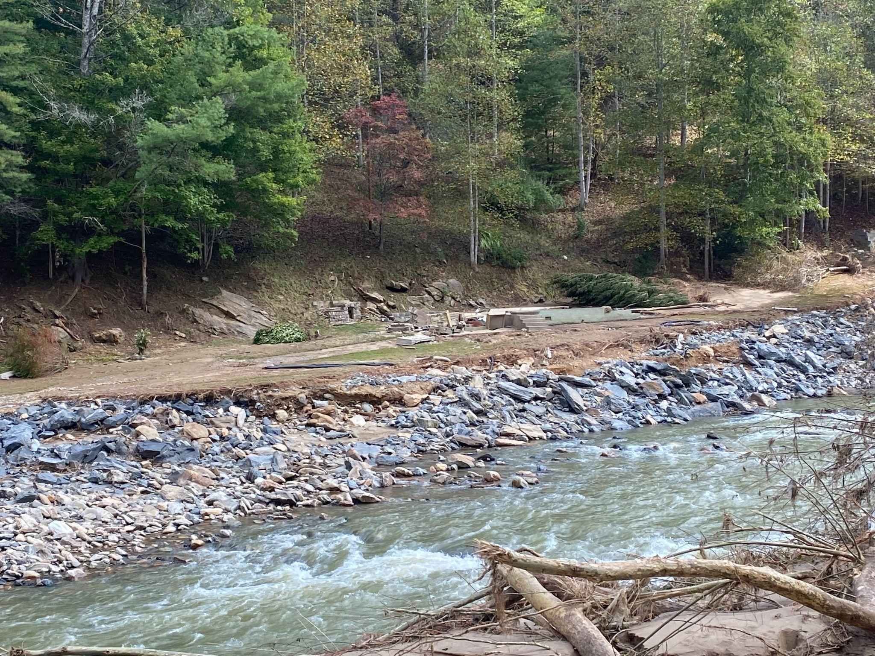
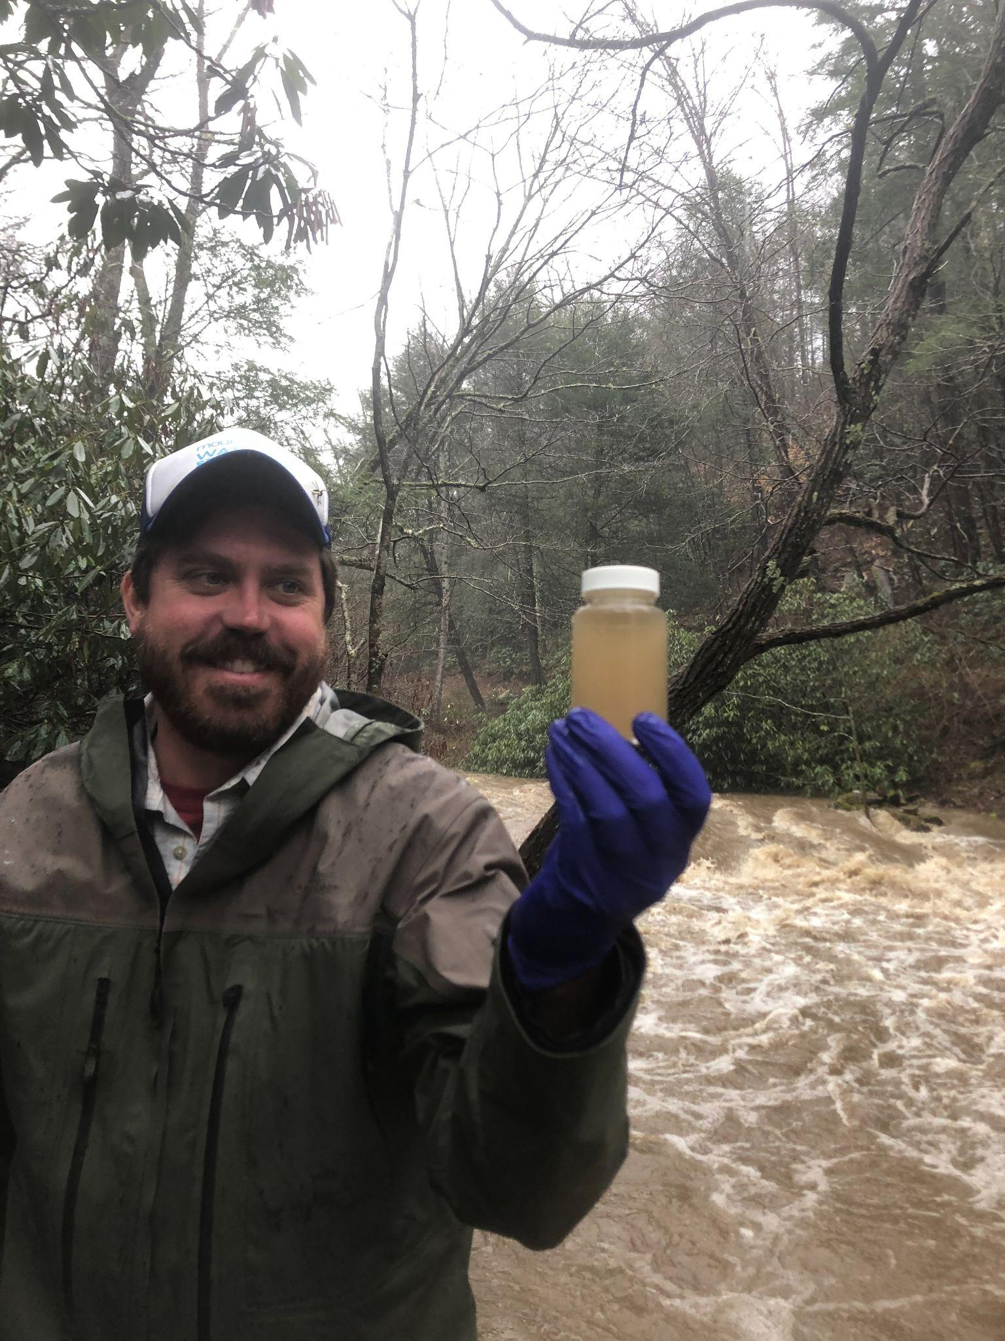
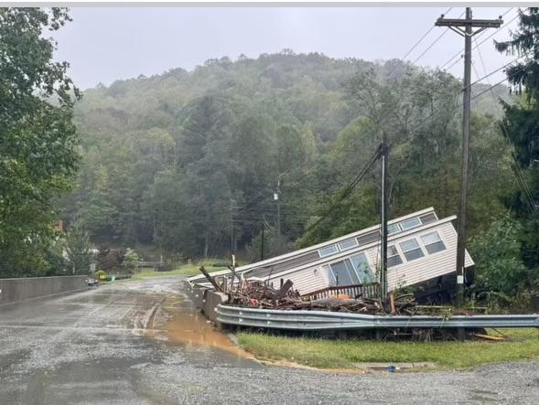
Documenting Impacts, Debris Inventory, and
Surface Water Quality Monitoring

Slide 9
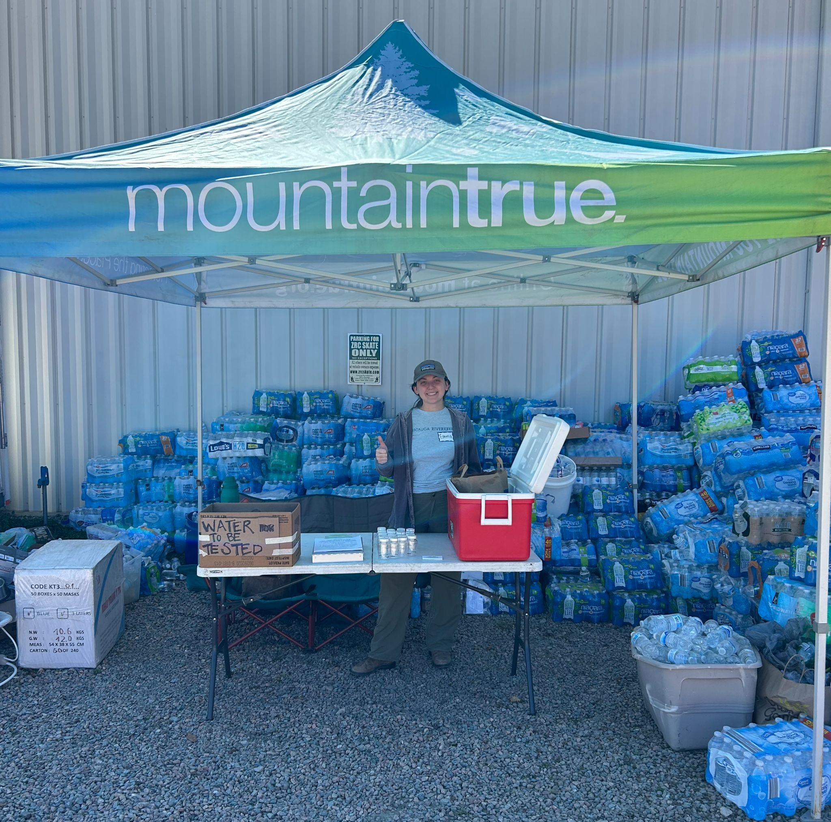
Our Riverkeepers tested hundreds of drinking wells across WNC in partnership with NC DHHS and Riverkeepers across the south. We also distributed hundreds of filters supplied by Wine to Water. We found about 30% of wells were contaminated with
E. coli bacteria.

Slide 10
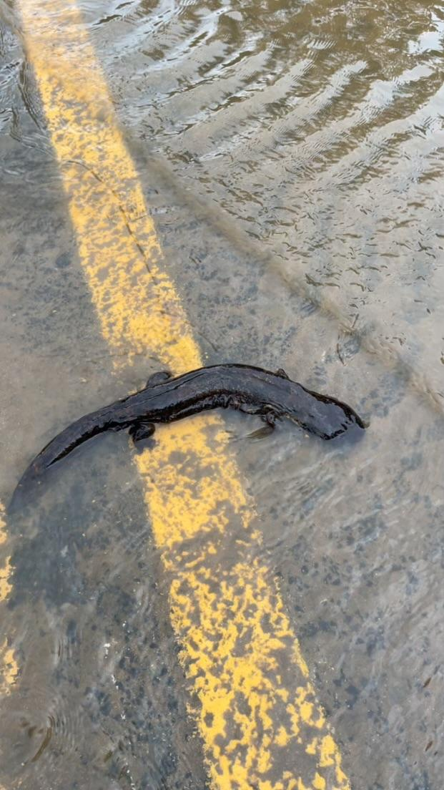
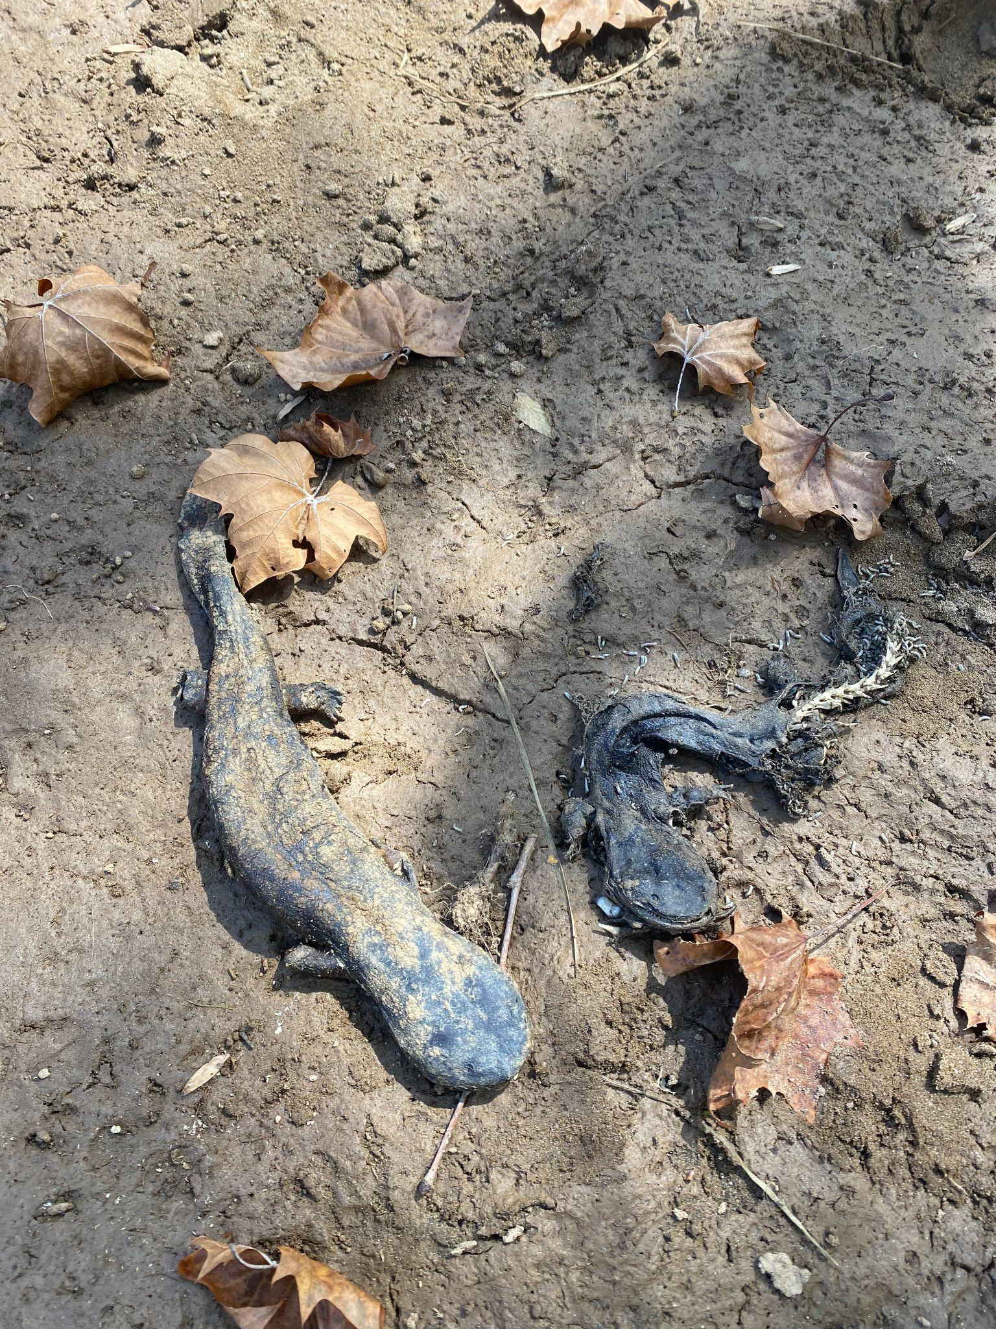
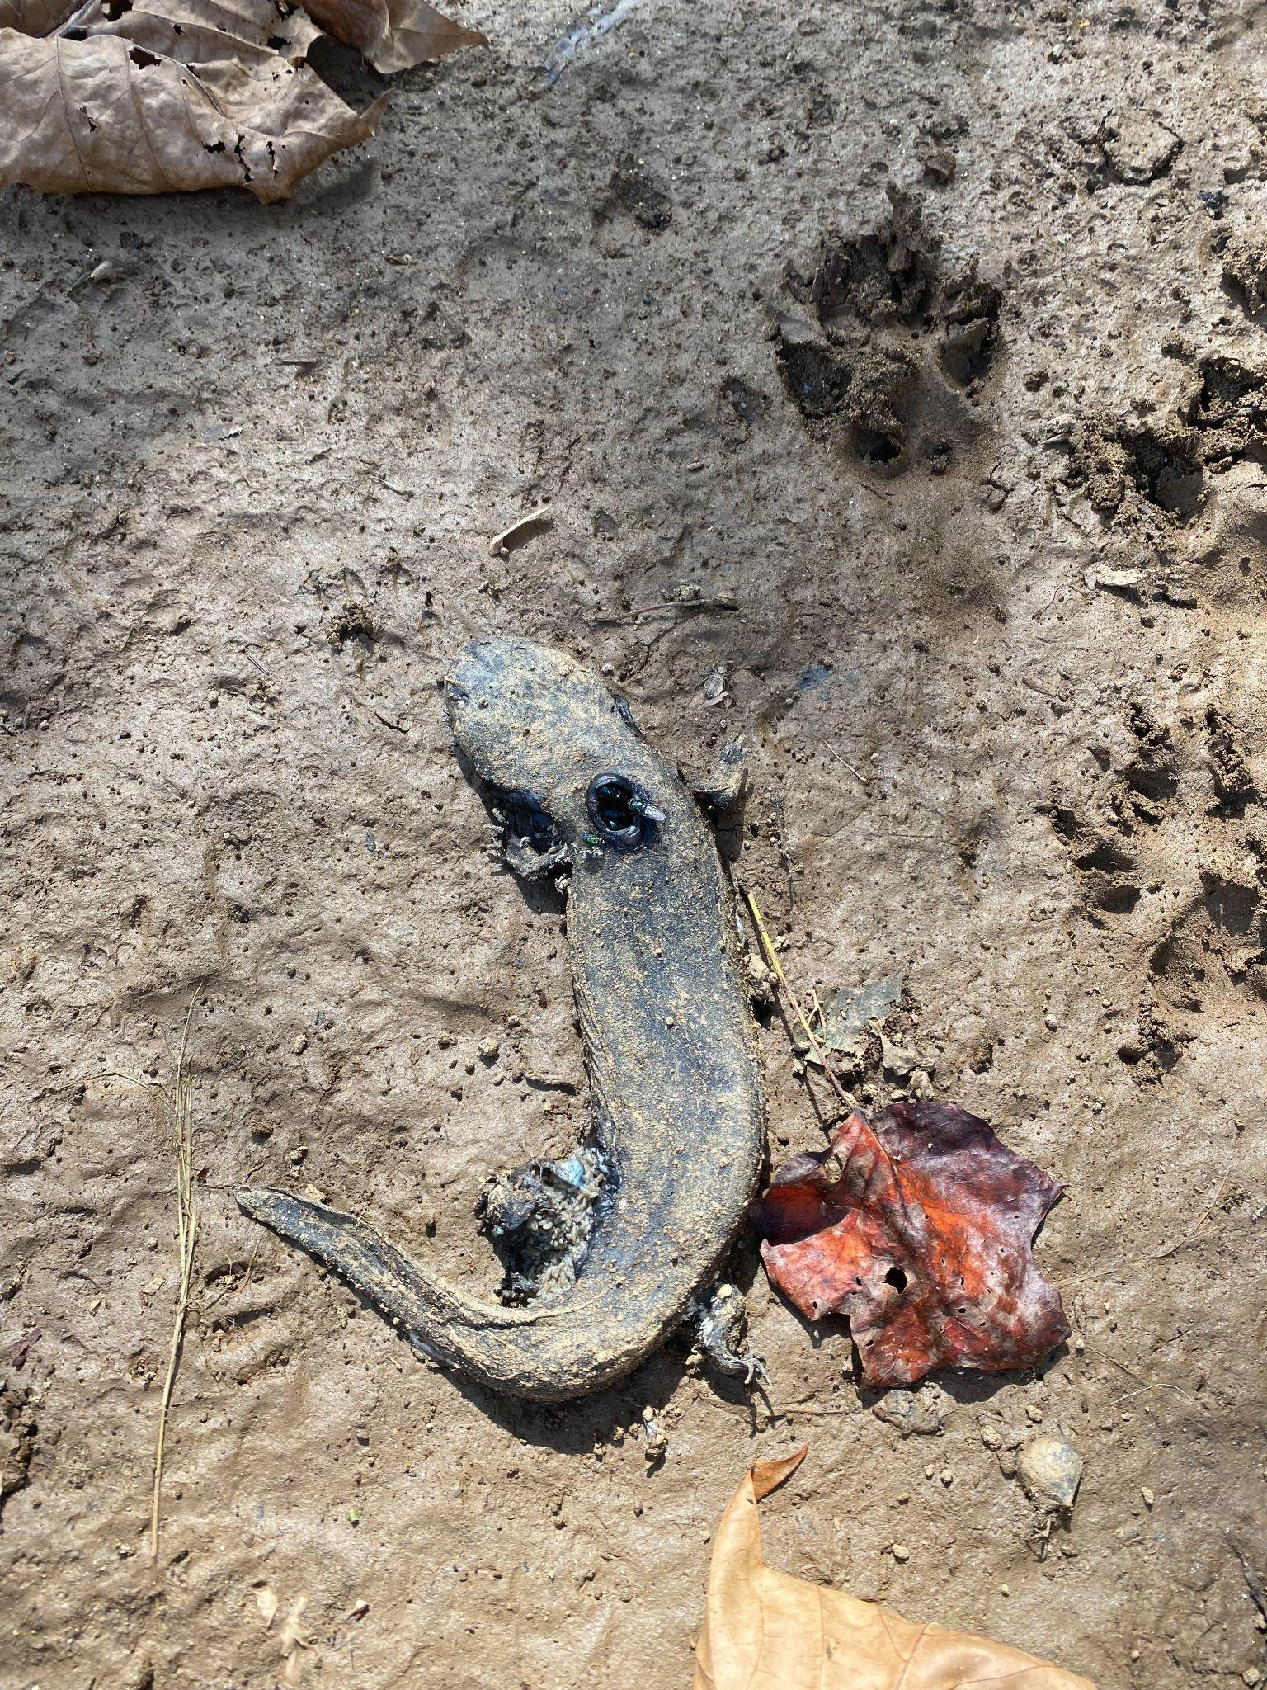
Documenting Ecological Impacts

Slide 11
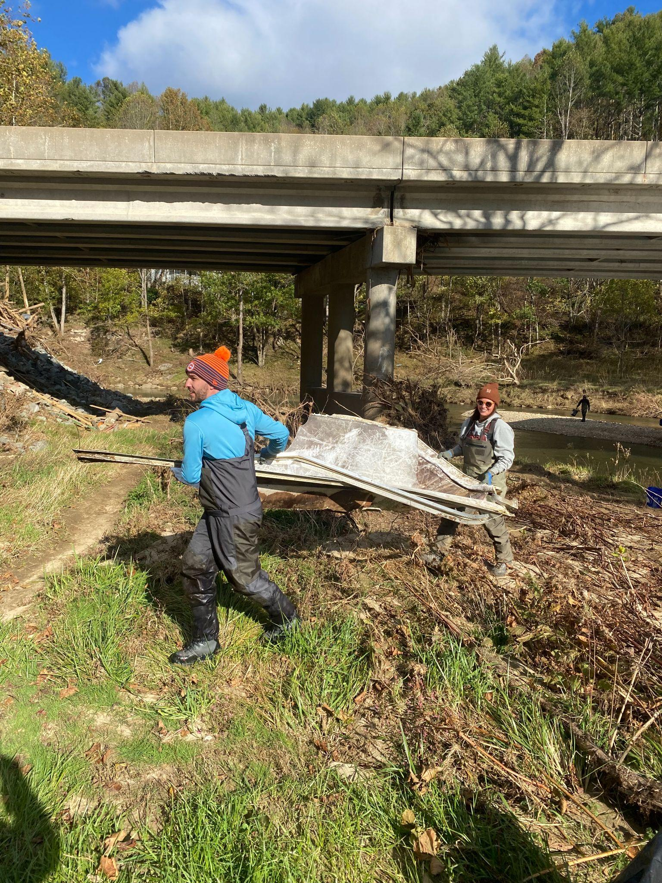
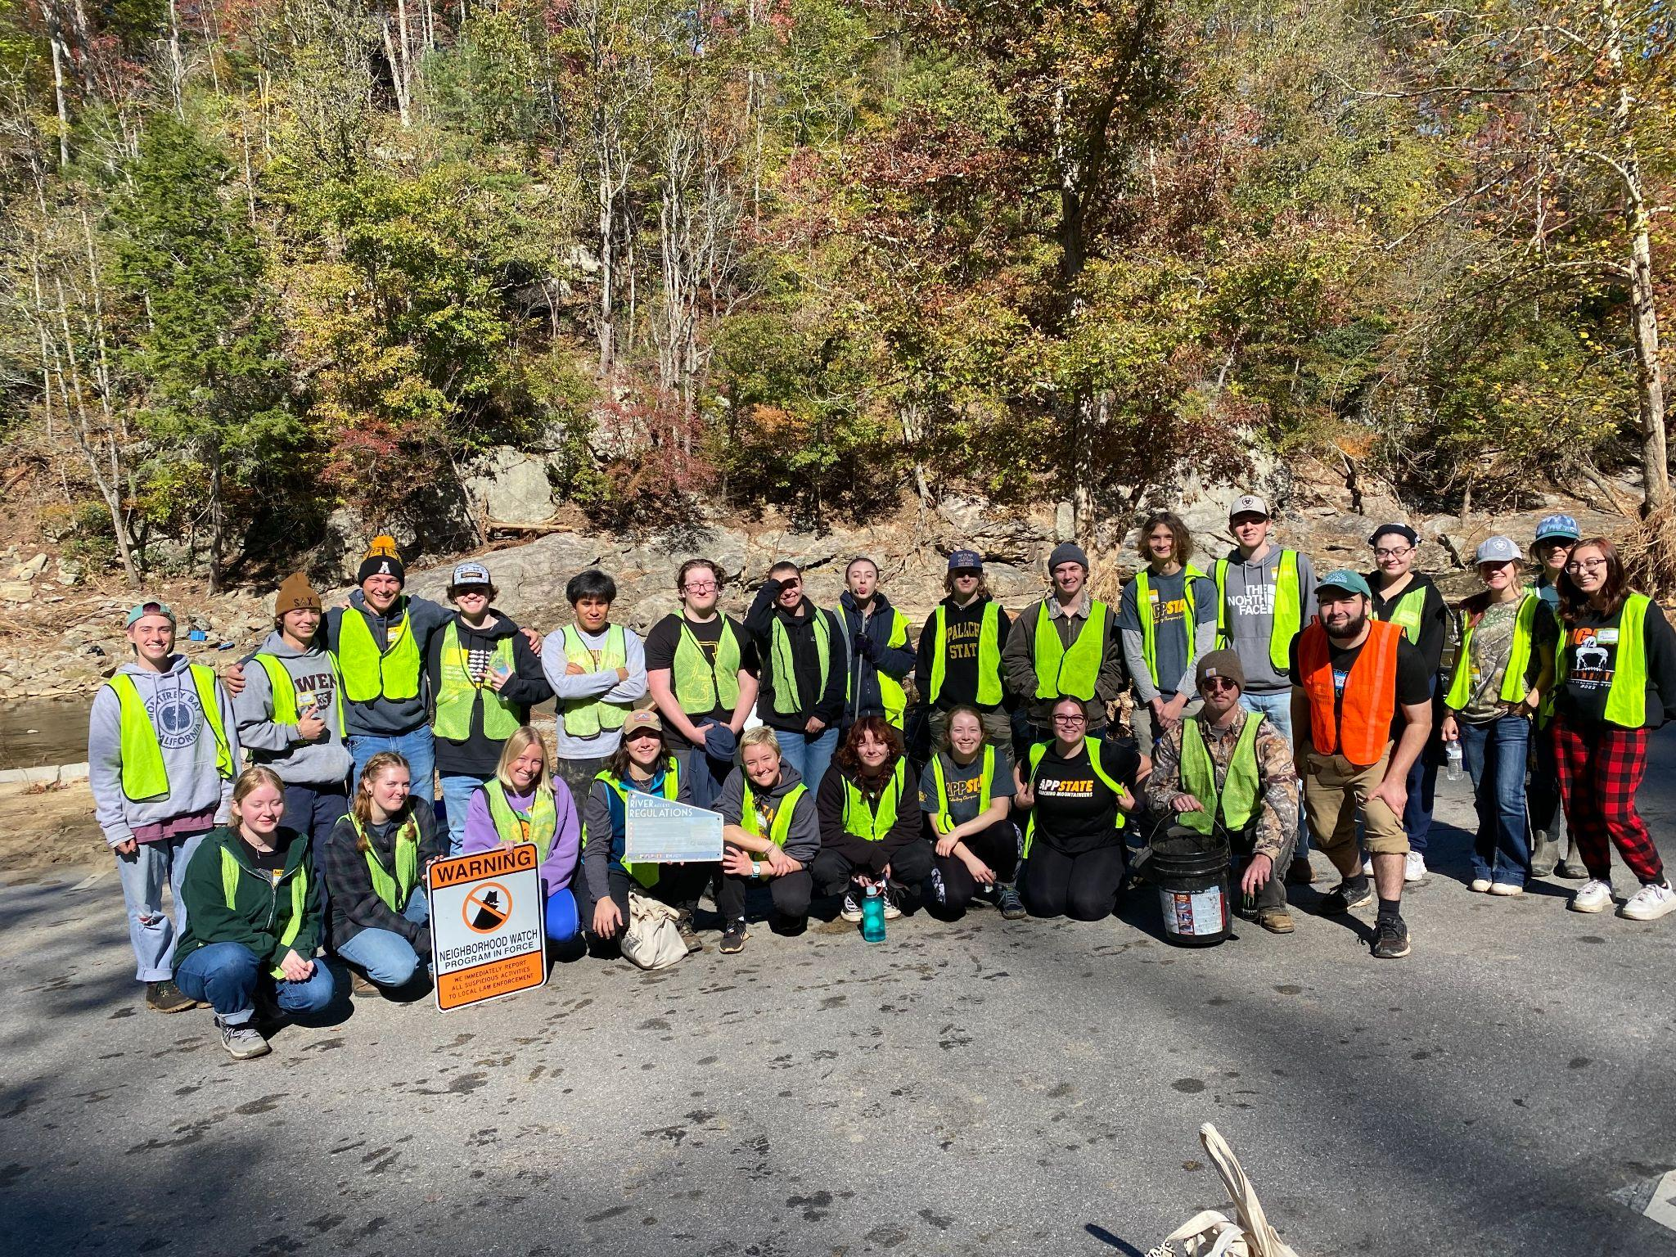
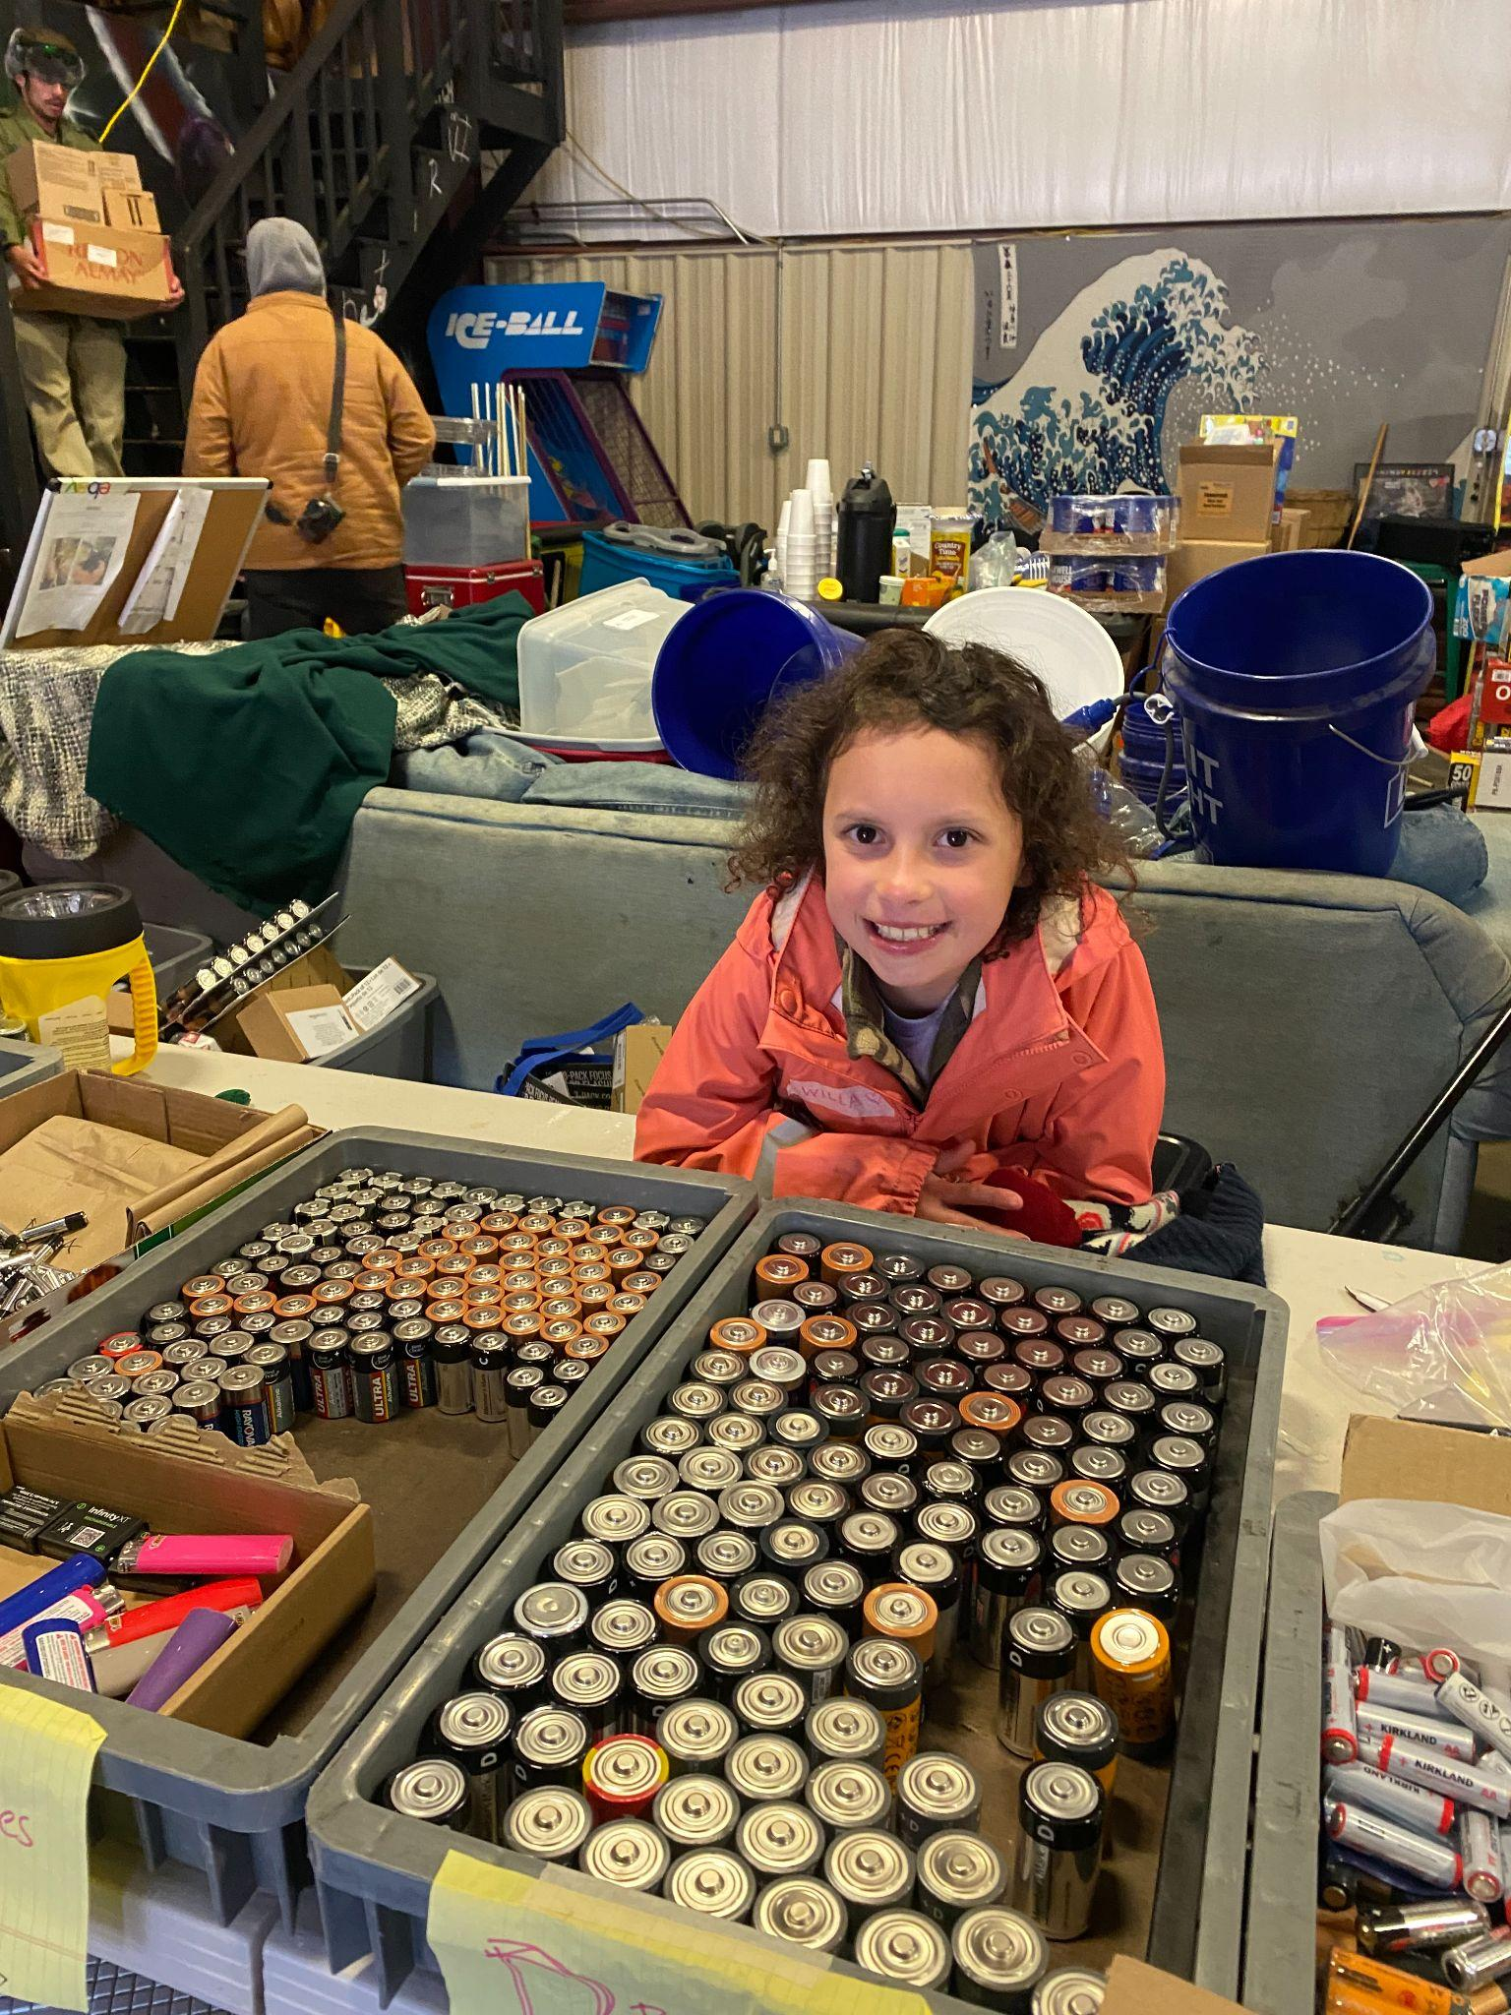
Ongoing River Cleanups and supply distribution

Slide 12
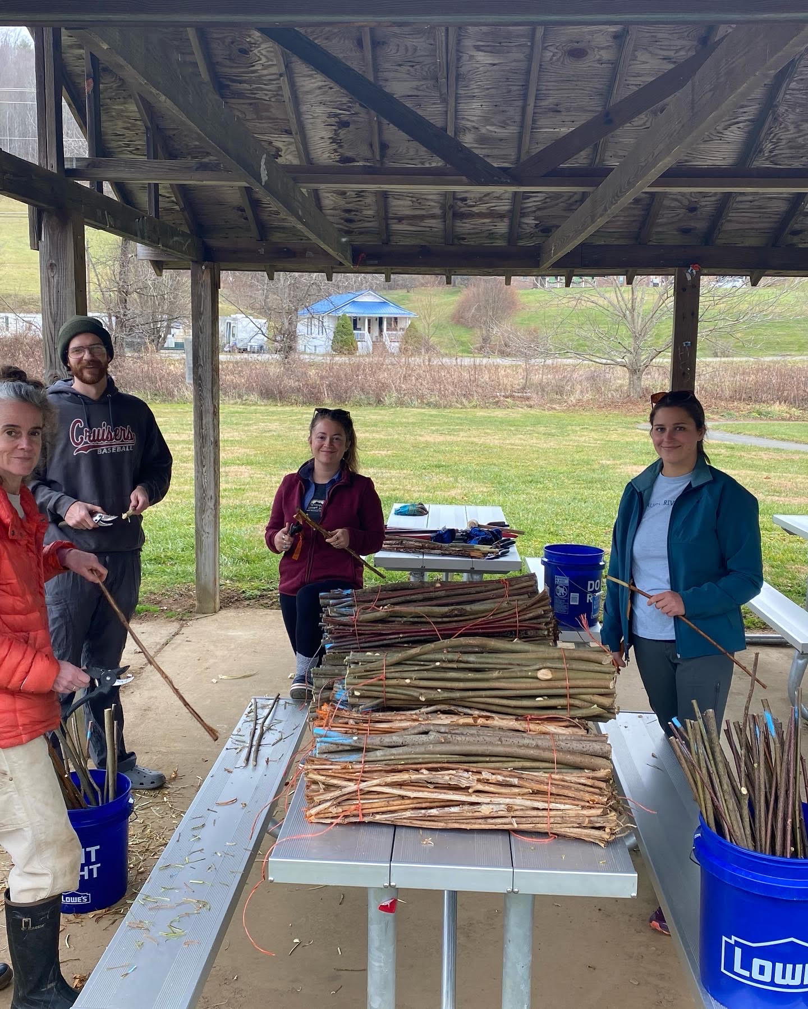
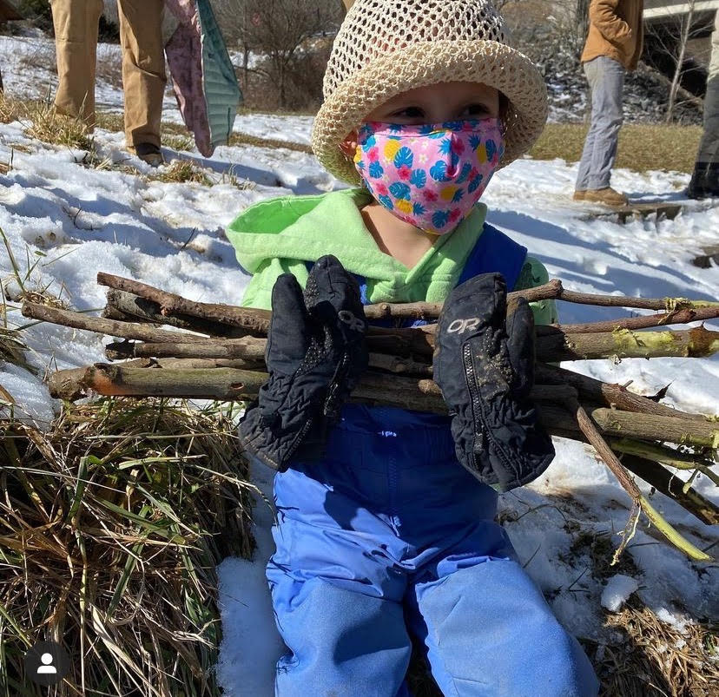
Reforesting our watershed with livestakes

Slide 13
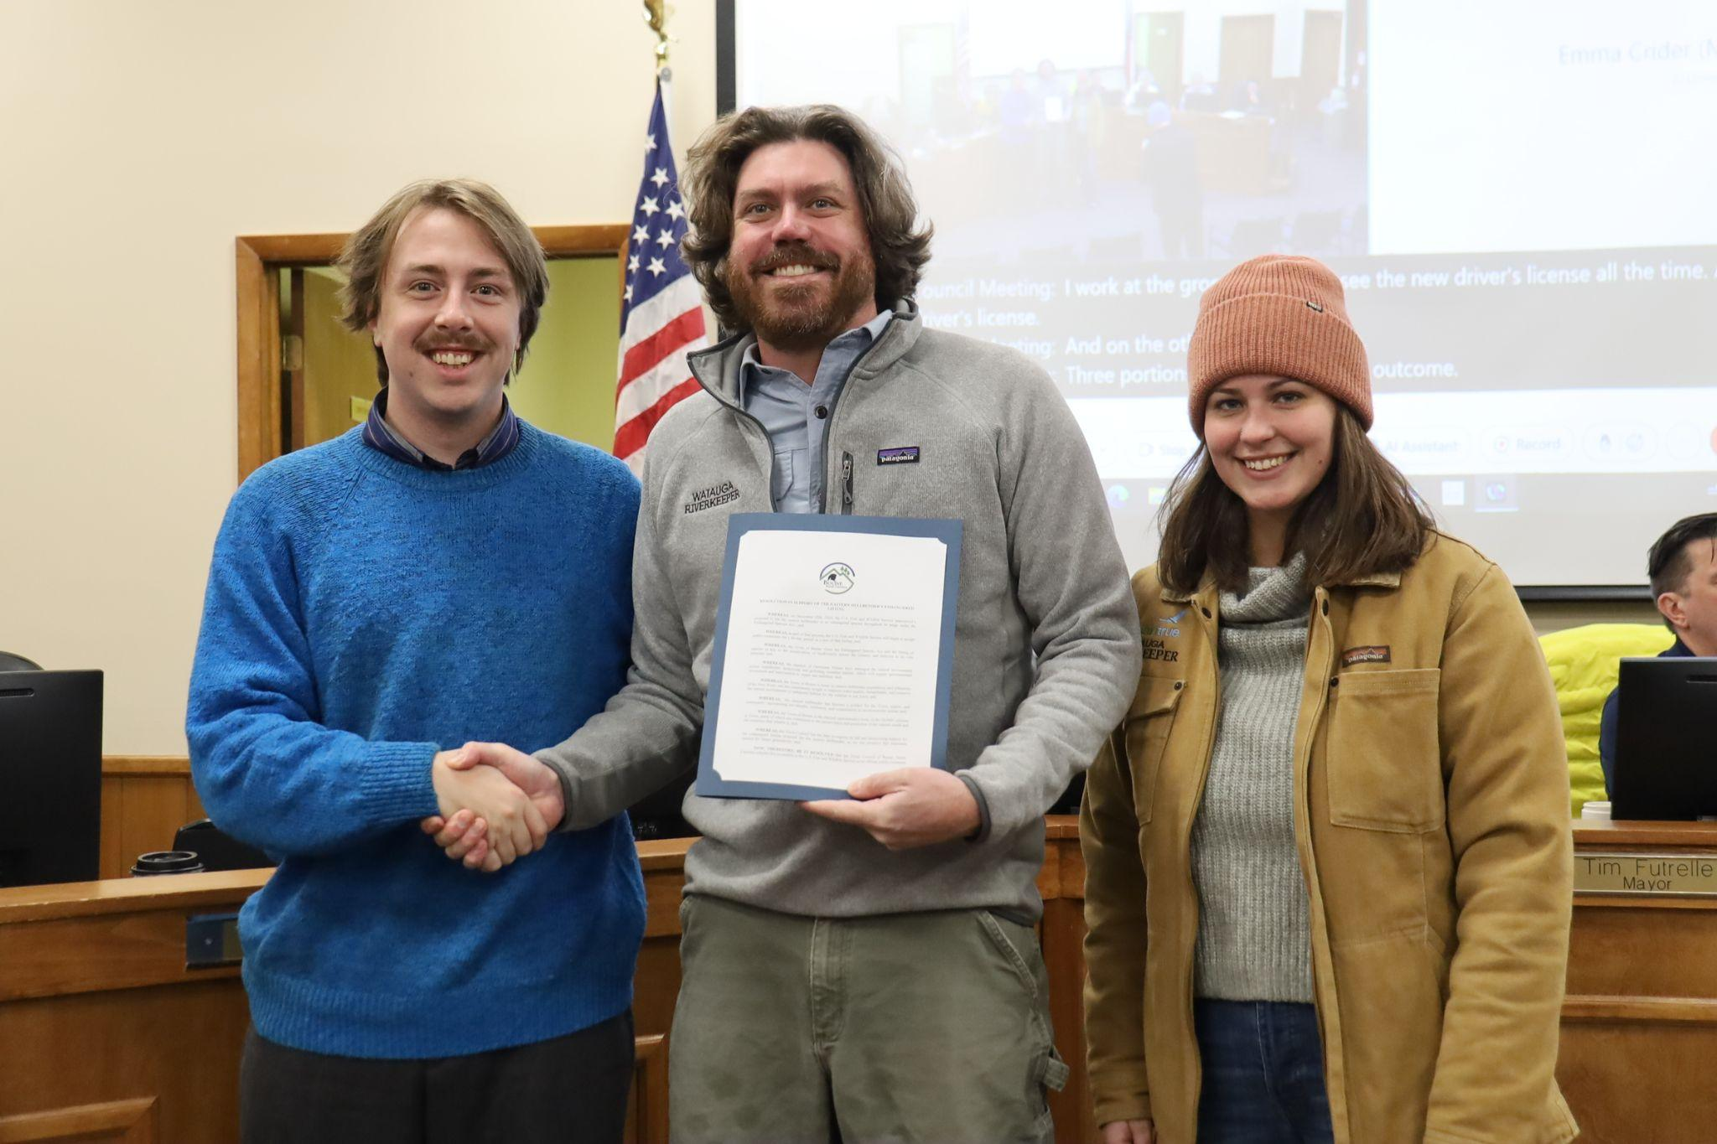
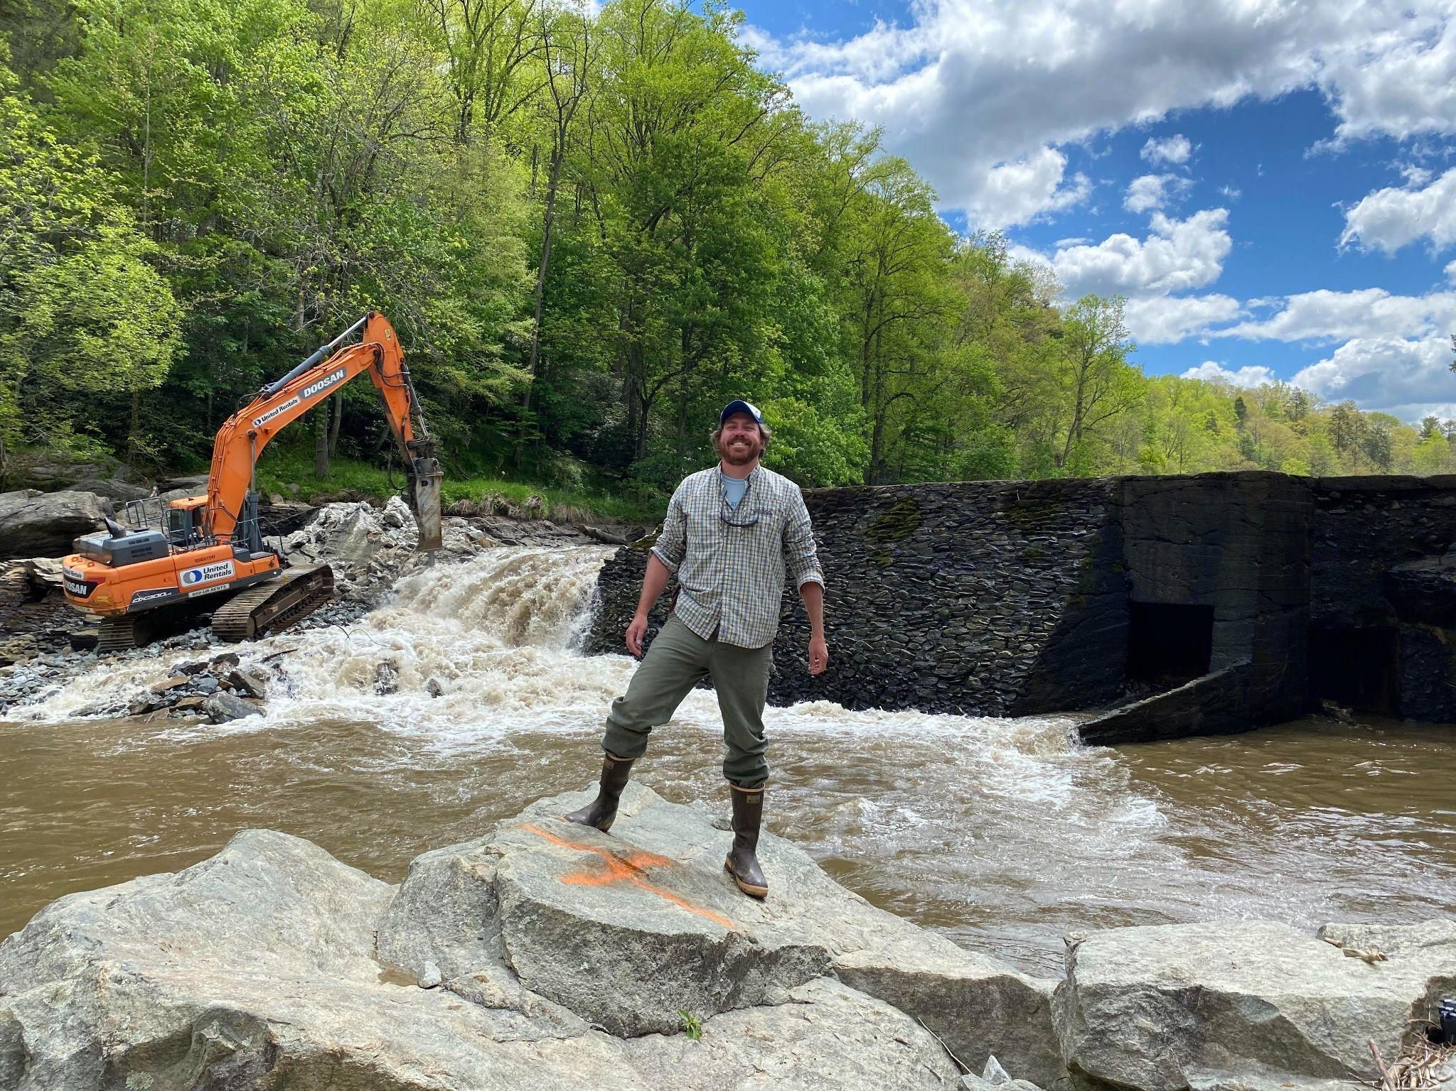
How can we make the High Country more resilient?
Policy Solutions: How and where should we rebuild? Engage with local, state, federal governments on climate policy.
Embrace and Invest in your local food system
PLANT TREES! Healthy Riparian zones are crucial for flood resilience.
Support aggressive dam removal and
reforestation initiatives.

Slide 14
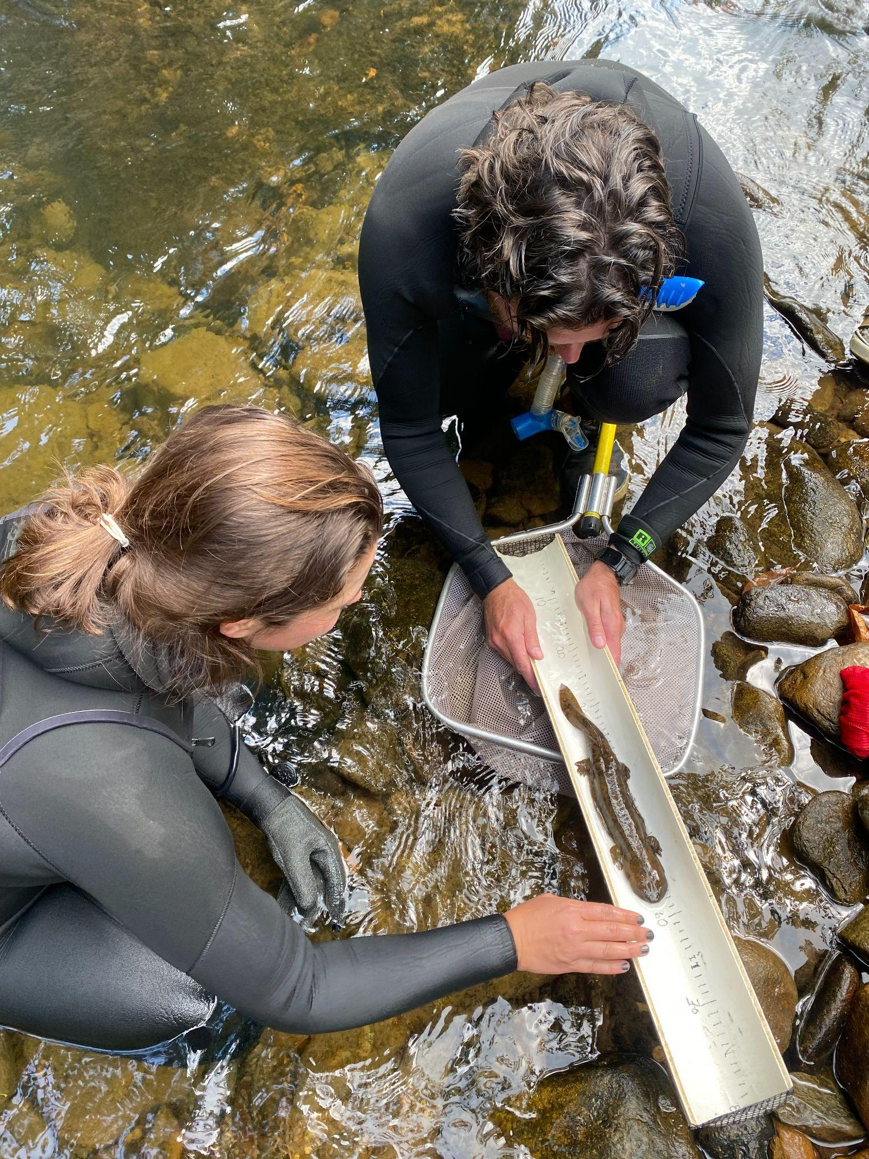
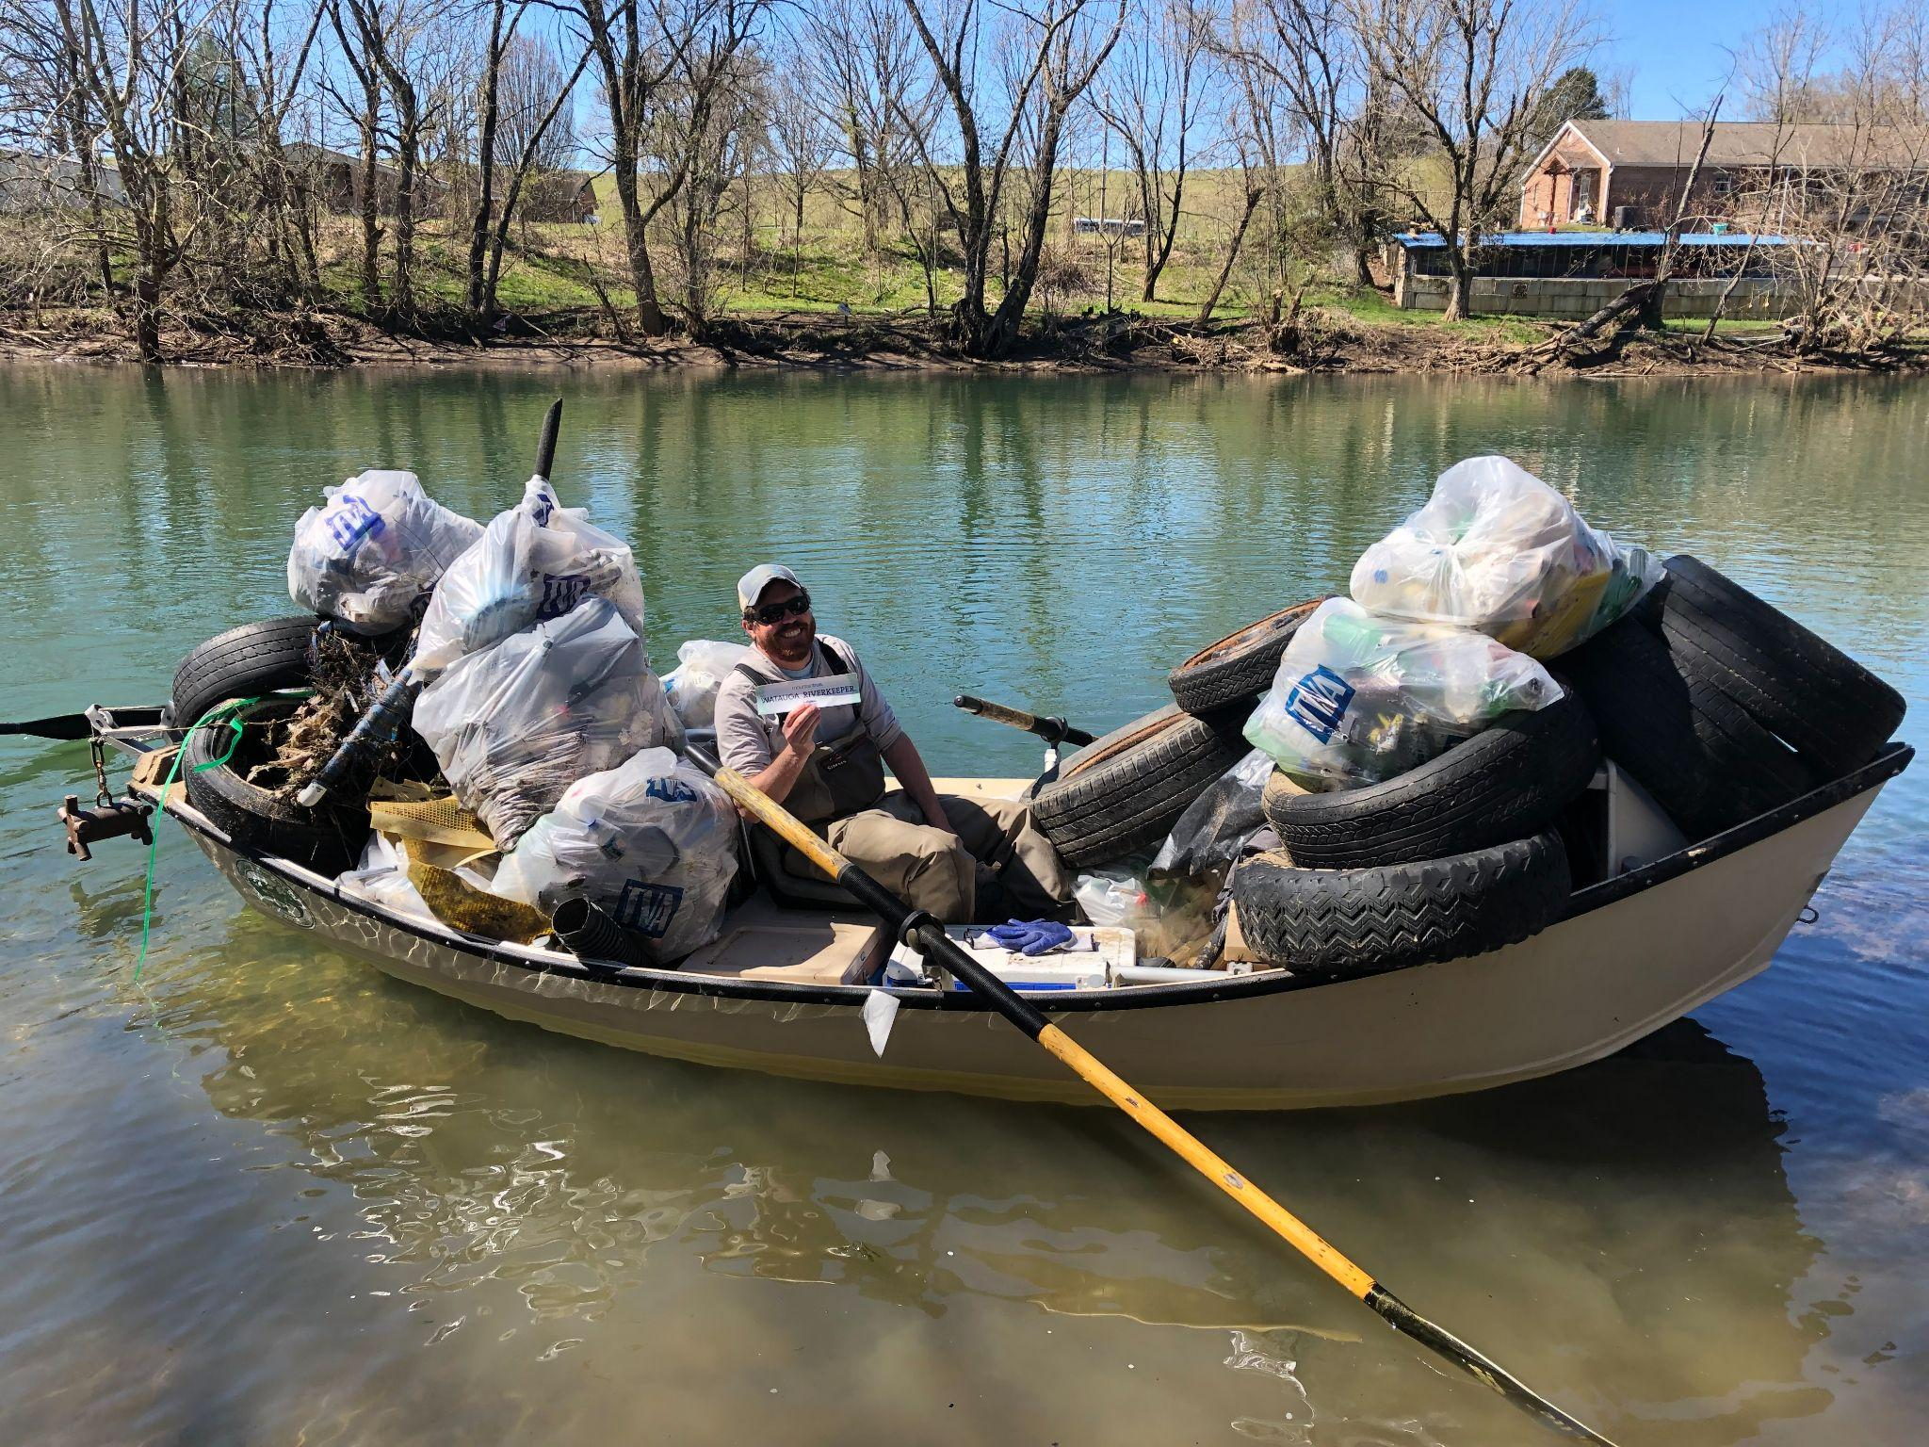
Get involved with MountainTrue
mountaintrue.org/eventscalendar
mountaintrue.org/protect-hellbenders

Slide 15
Kellie Reed Ashcraft
Executive Director
Watauga Housing Council

Slide 16
Snapshot of Housing-Related Concerns
Pre-Helene Snapshot
37%-Watauga Housing Cost-Burden
Aging Housing Stock
0%-Vacancy Rate of Multi-Family/Off-Campus Student Rentals
Post-Helene Snapshot
*6755 Watauga FEMA registrations (*undercount-only FEMA!)
951 FEMA approved-Housing Assistance
2 households placed & 6 approved-FEMA TTHUs

Slide 17
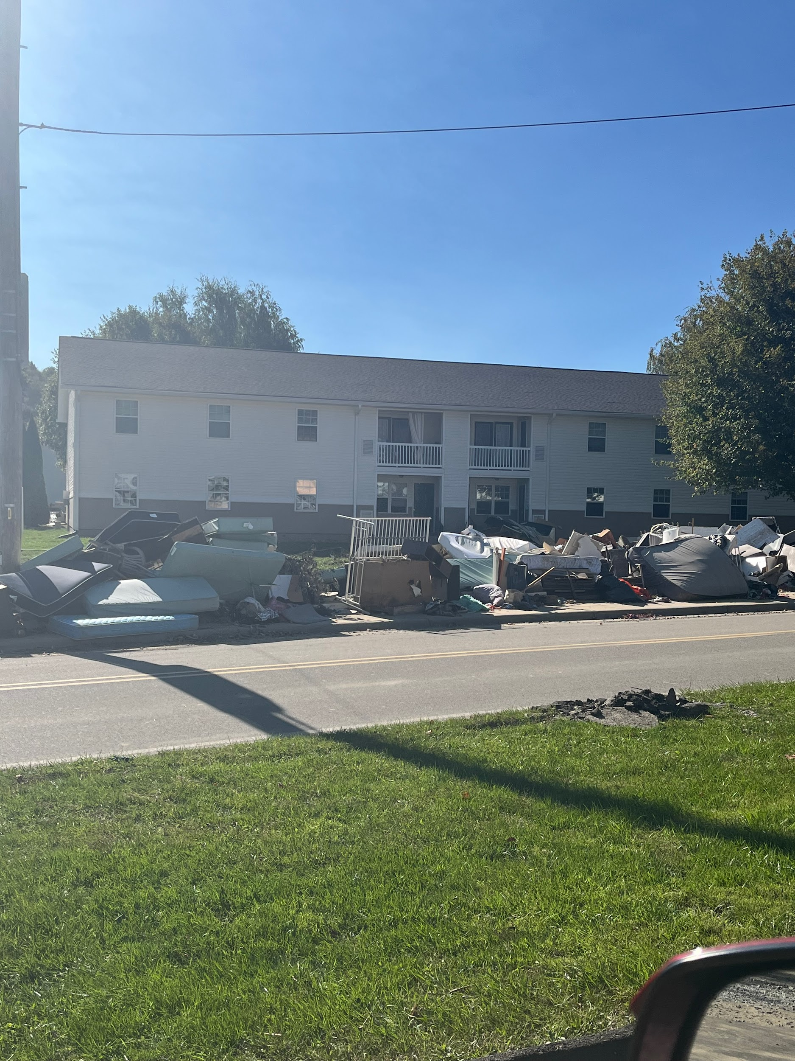
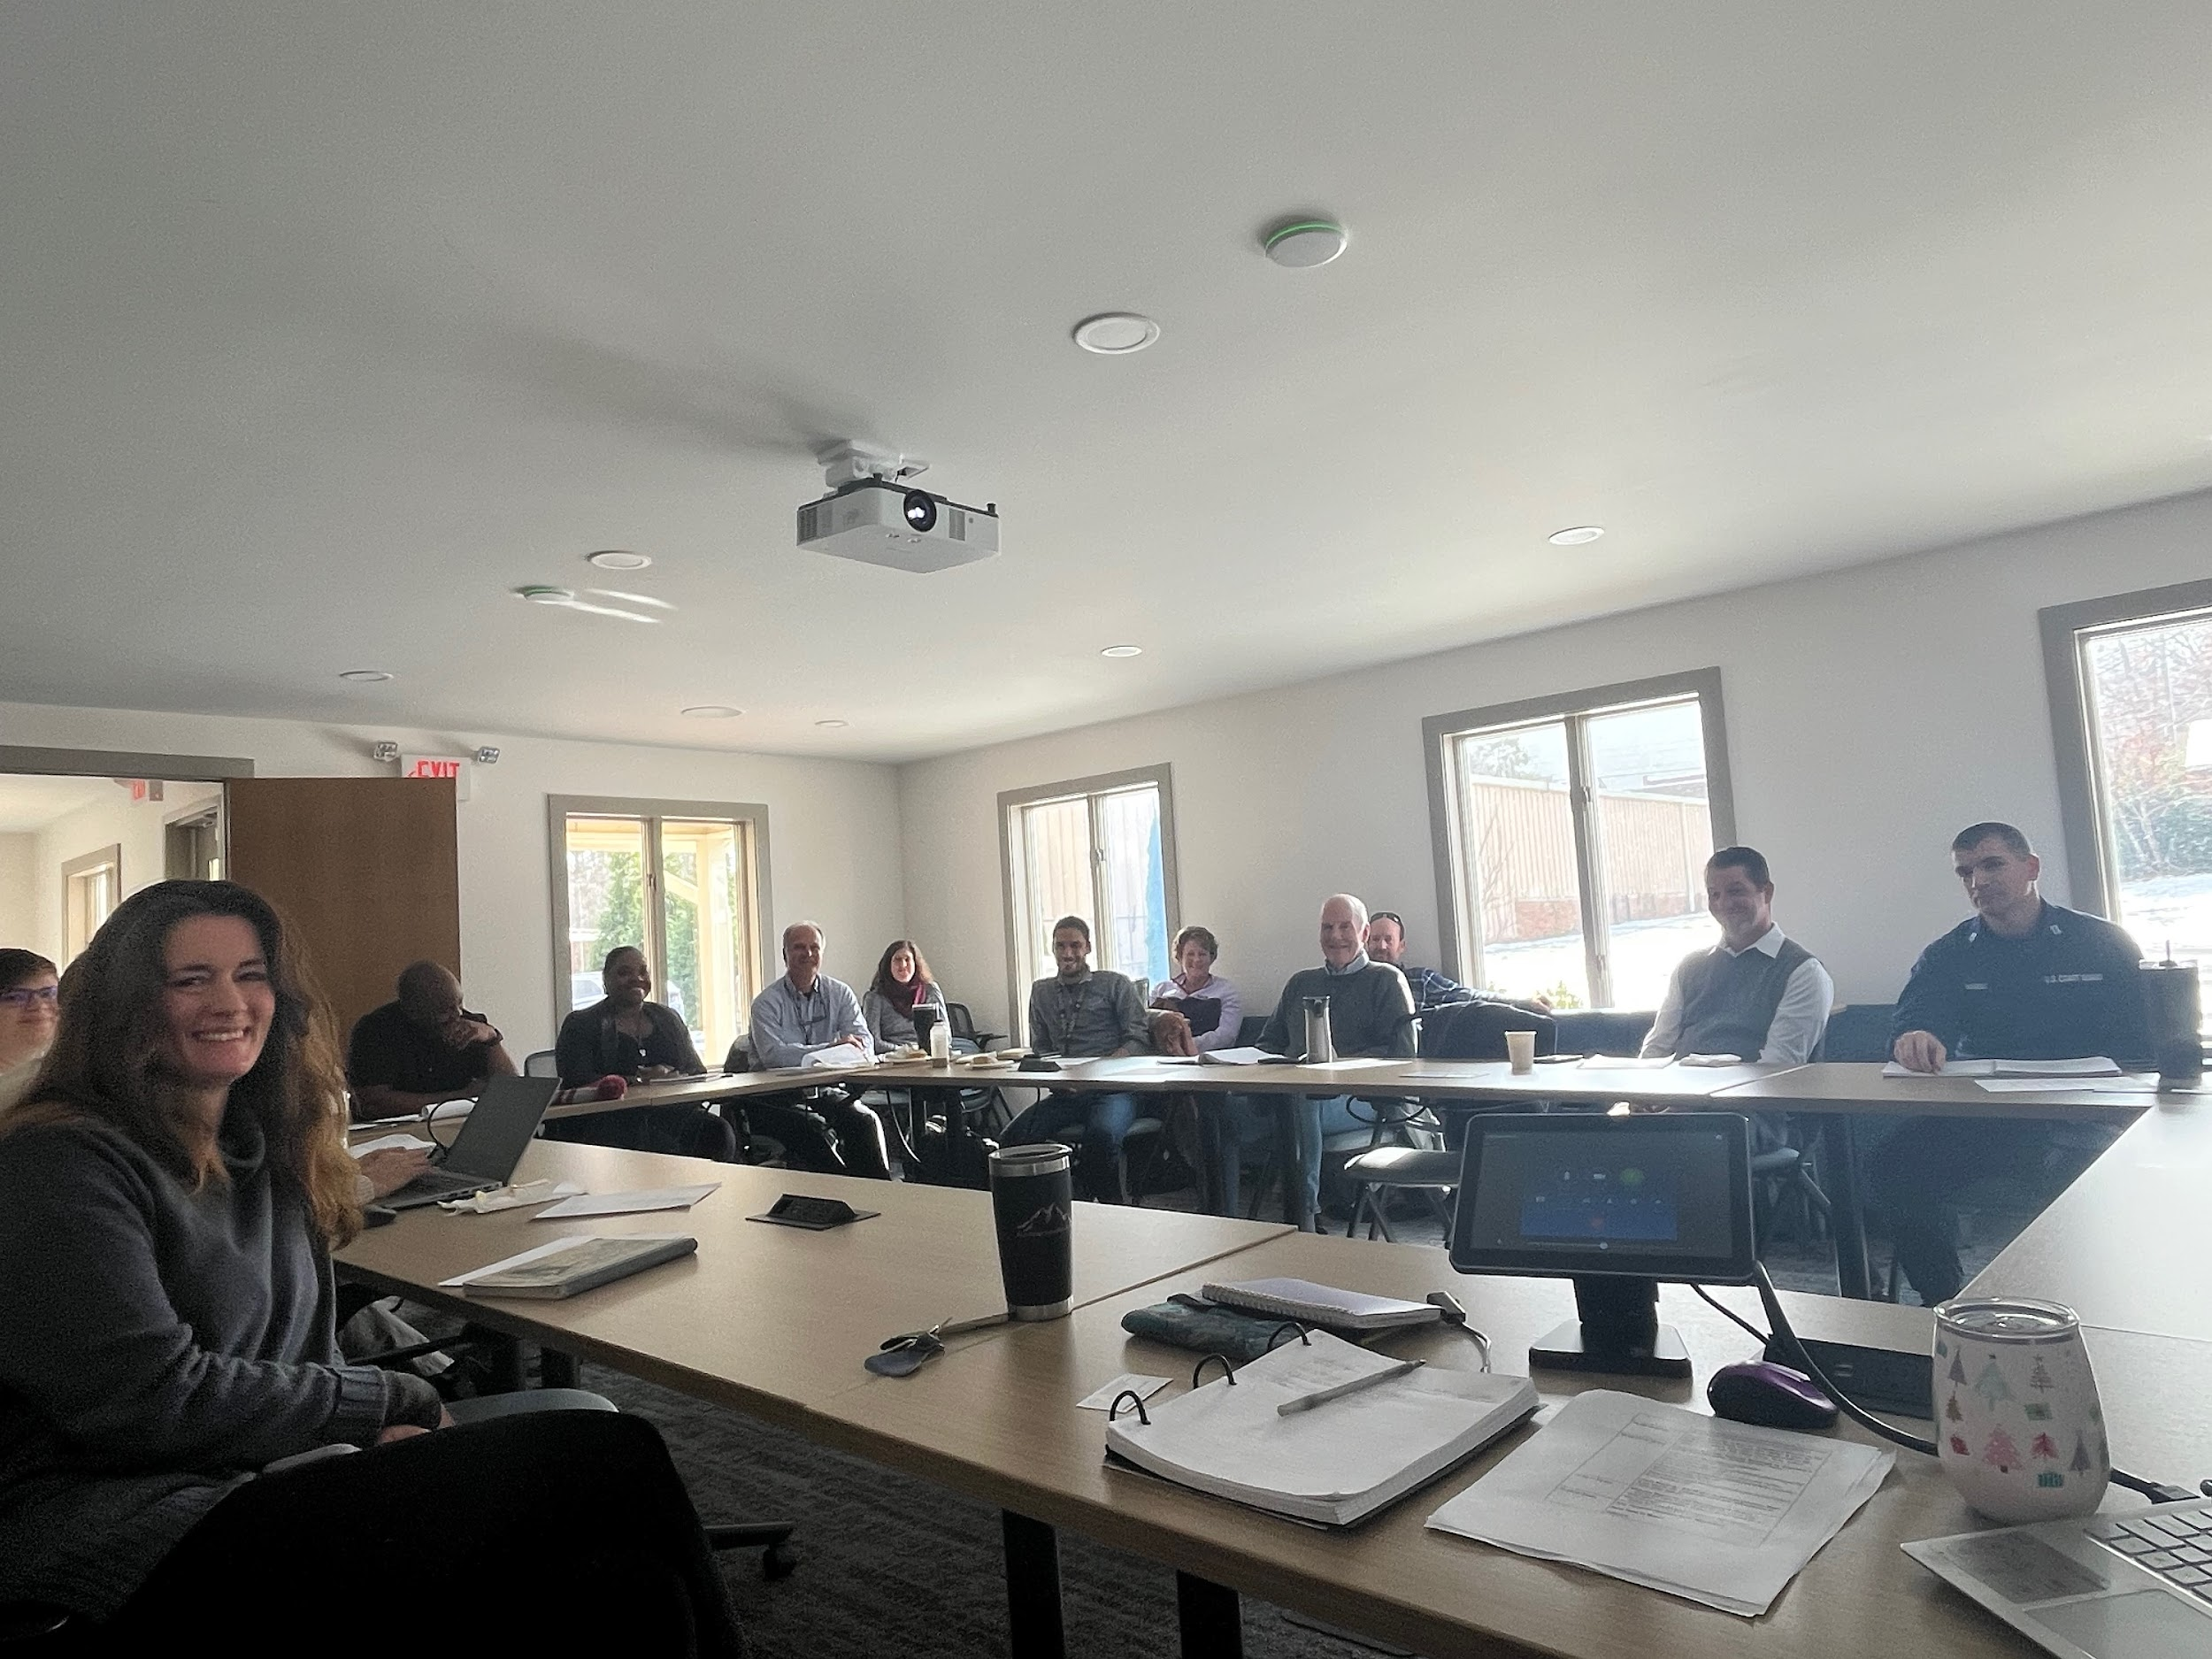
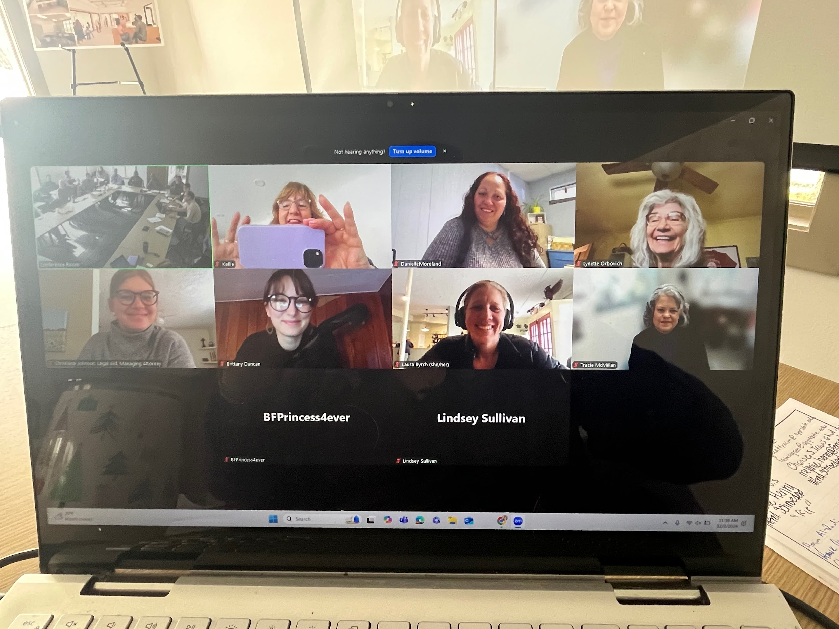
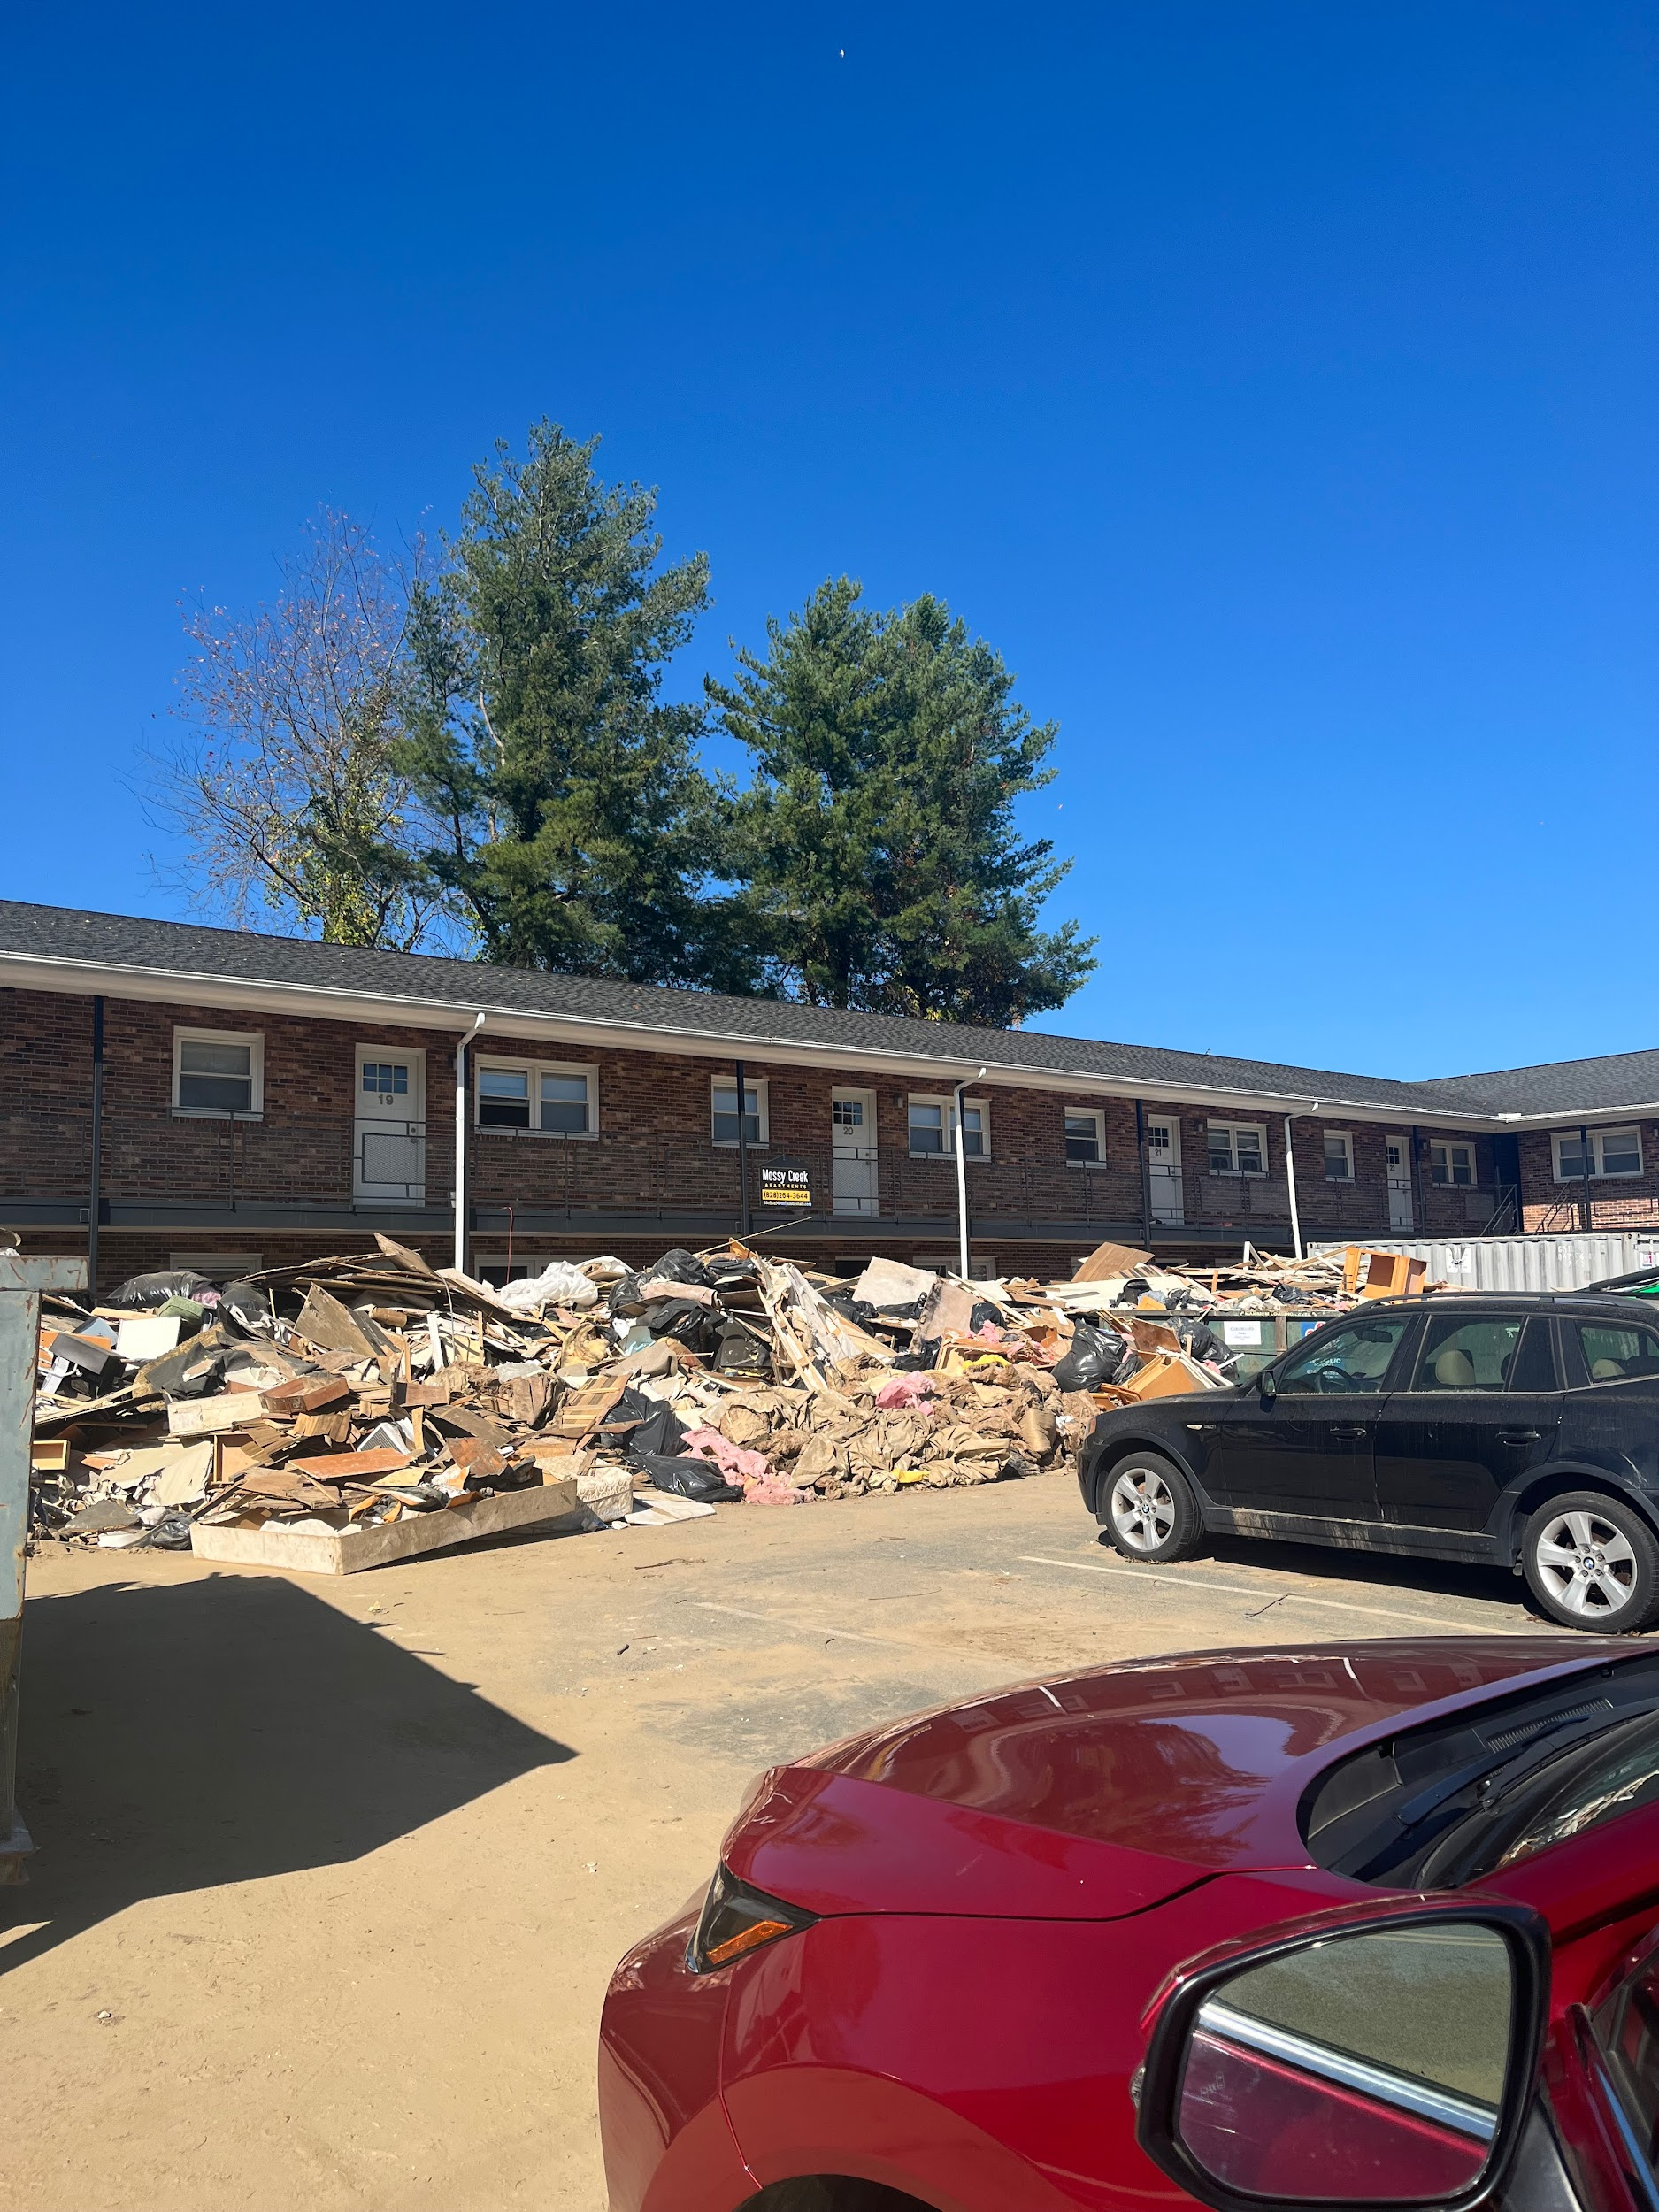
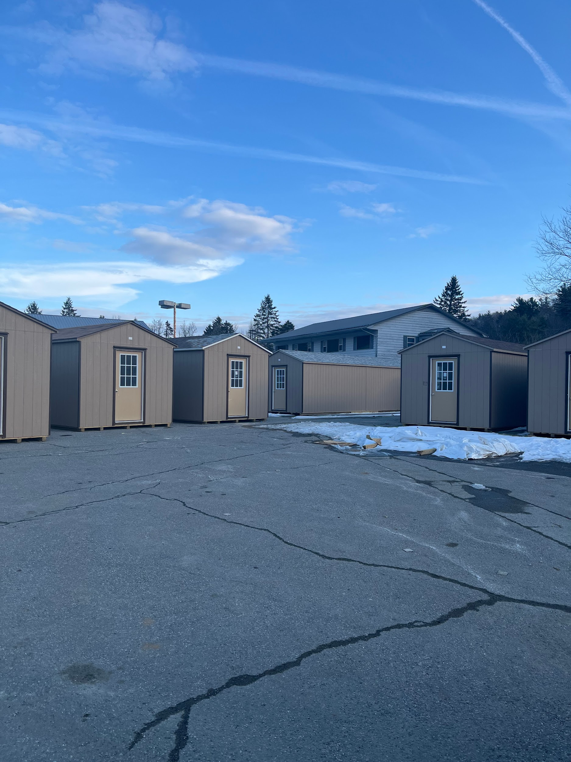
Post-Helene Housing & Housing Response

Slide 18
Community Housing Response & Resiliency
Post-Helene
Immediate & Intermediate
Neighbor to Neighbor & Individual Community
Local Churches & Nonprofits
FEMA
External Private Support
Regional/National Churches & Nonprofits
Intermediate & Long-Term
Local Support
High Country Housing Partners
Long-Term Recovery Groups
Local, State, Federal Government

Slide 19
What Are We Learning To Make Us More Resilient?
Communication
Have Local Groups as Key Partners
Involve in EM Protocols
Partner FEMA w/ Trusted Locals
Develop Other Emerg. Comm. Methods
Immediate/Transitional Housing
Streamline Housing Codes
Encourage FEMA THA Participation
Develop “Lessons Learned” Report
Increase Local/Reg./Nat’l Connections
Intermediate/Long-Term Housing
Advocate & Secure Funding To “Build Back Better”!

Slide 20
How Can You/Interested Groups Contribute?
Participate!
Local Housing Efforts
Watauga Housing Council! (kellie@wataugahousing.org)
Watauga/Other LTRGs
Advocate!
Continued $ & Existence of FEMA
Helene-Impacted State/Federal Housing Funding
Increased LIHTC Funding
Housing Code/Zoning Reform
Support!
Funding to Local Housing Efforts
Funding to Helene-Related Reg./Nat’l Groups

Slide 21
David Jackson
President/CEO
Boone Area Chamber of Commerce

Slide 22
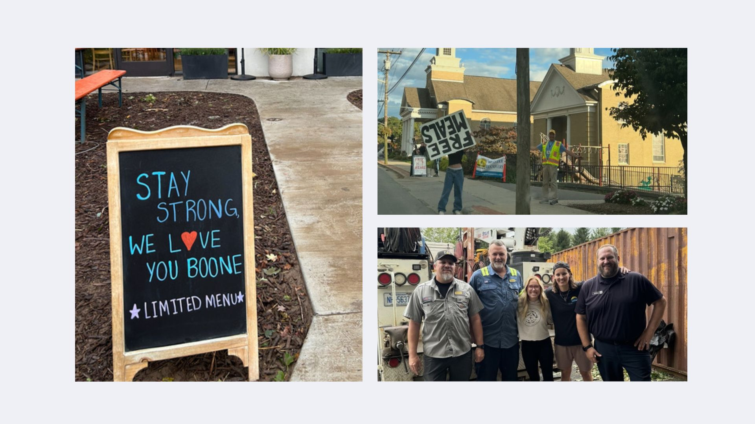
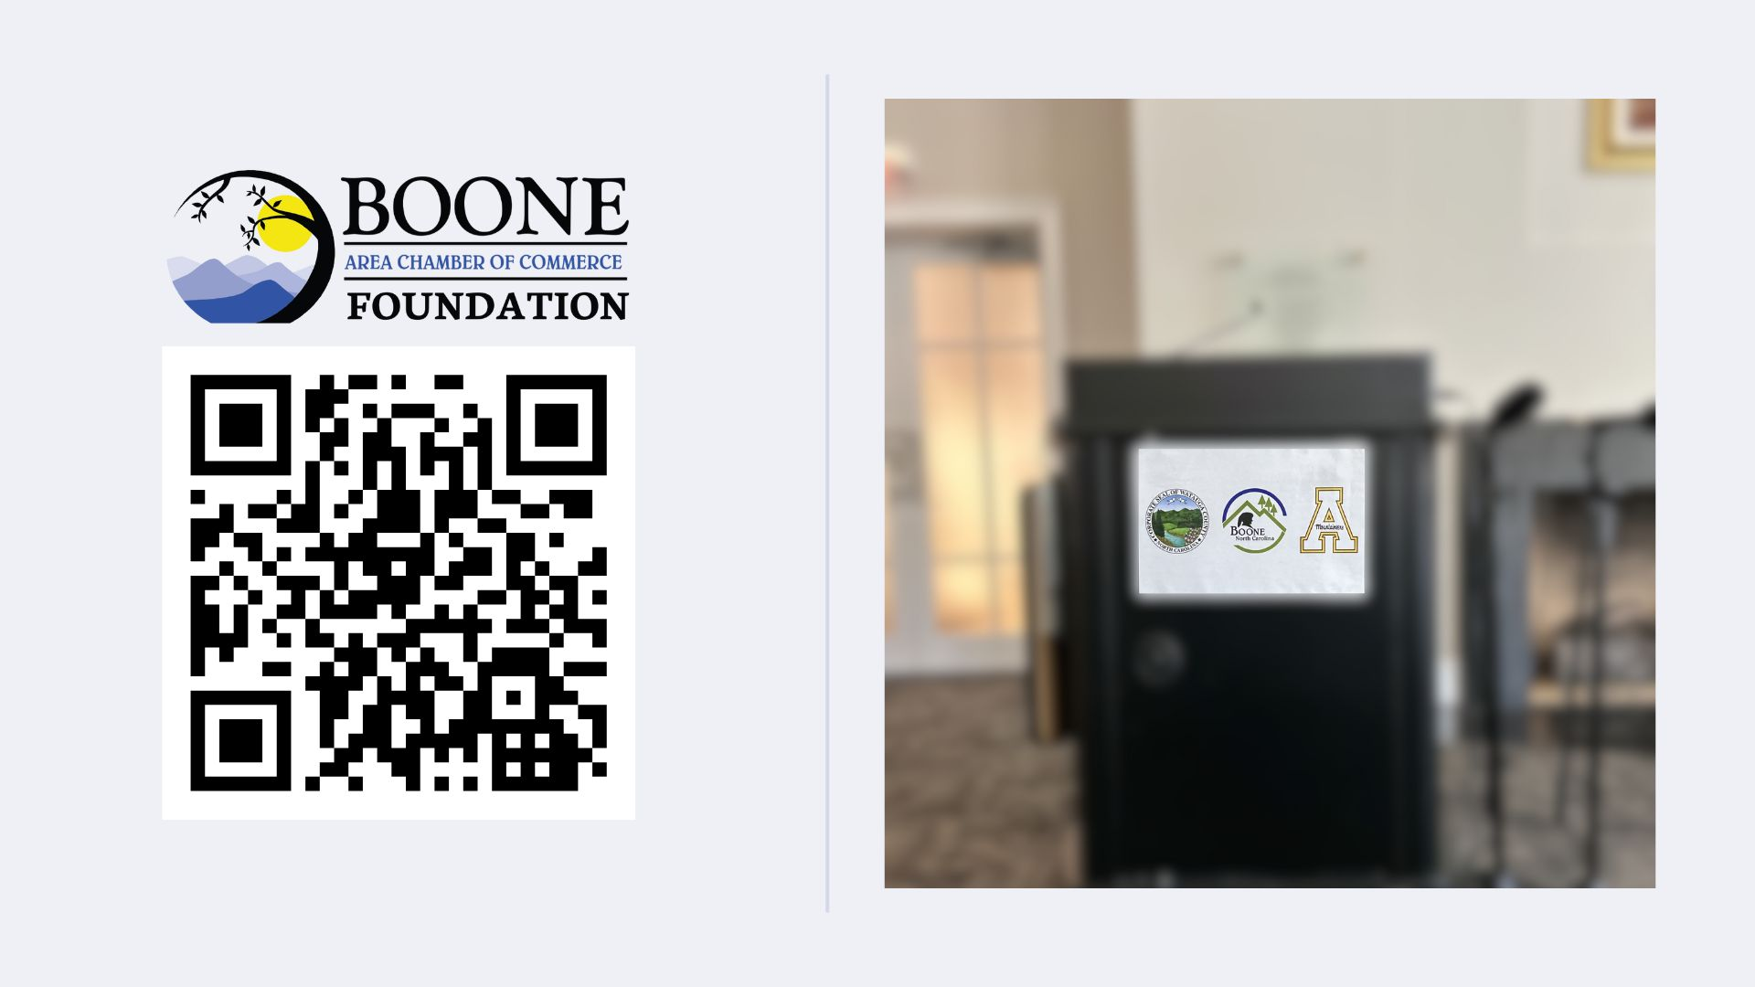
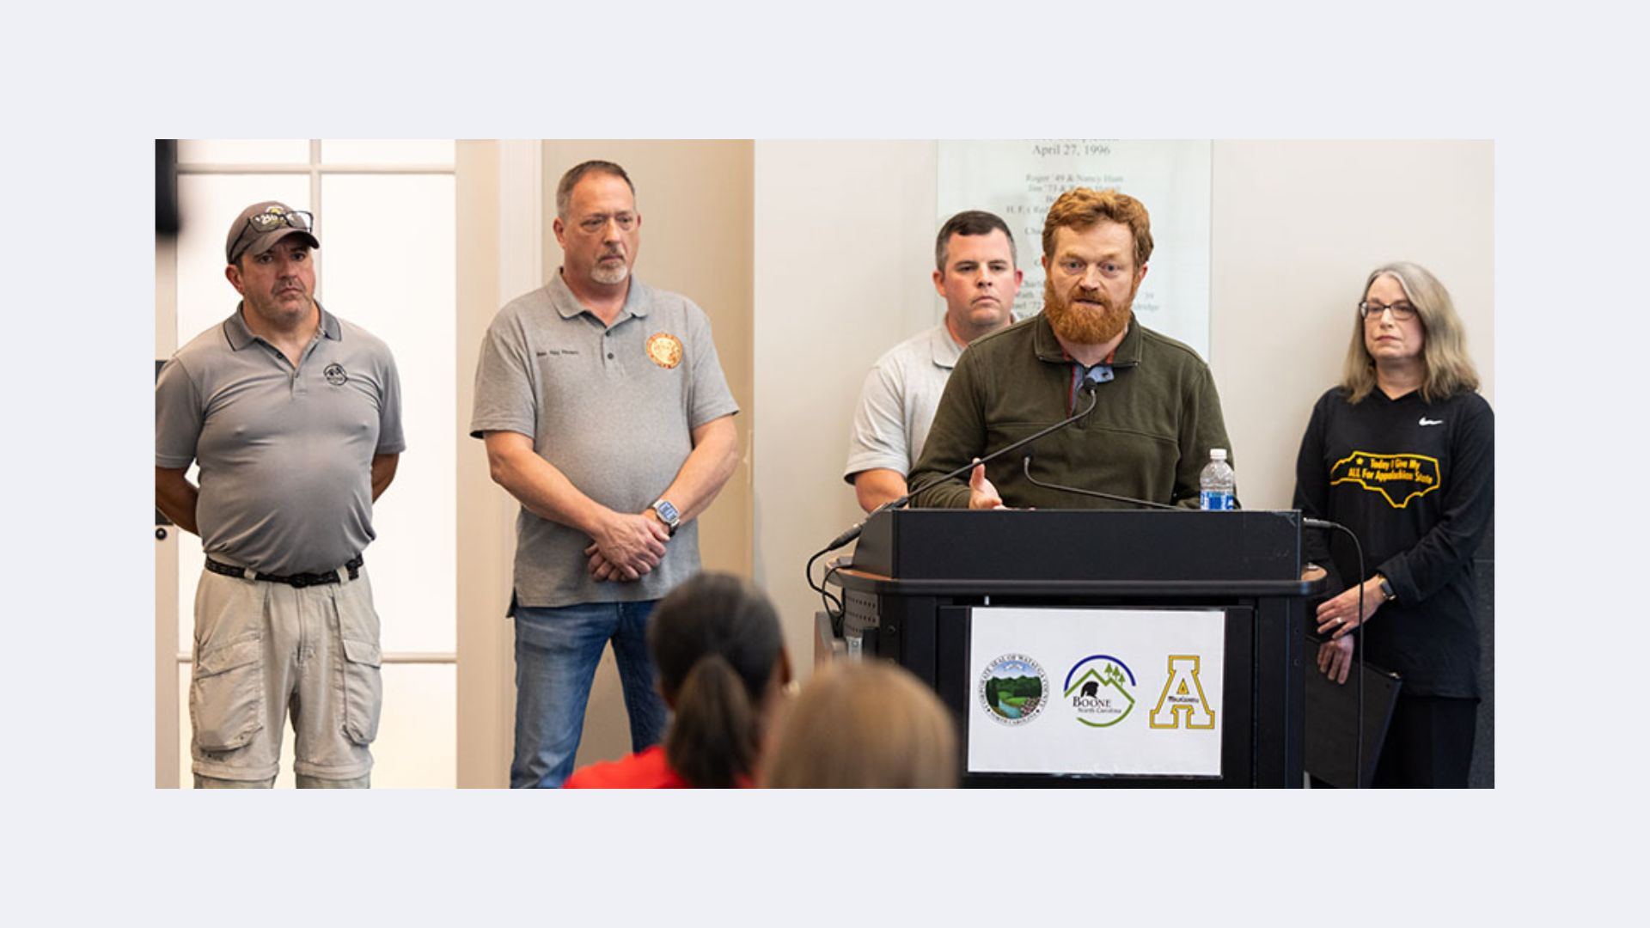
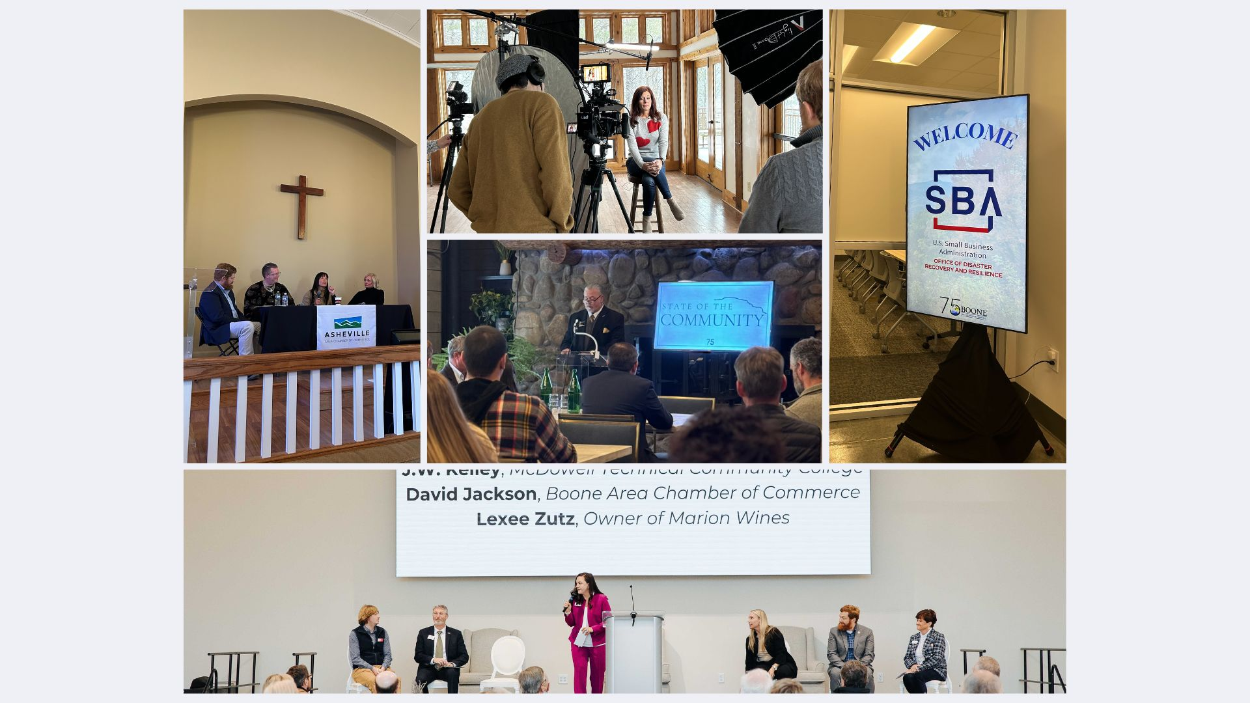
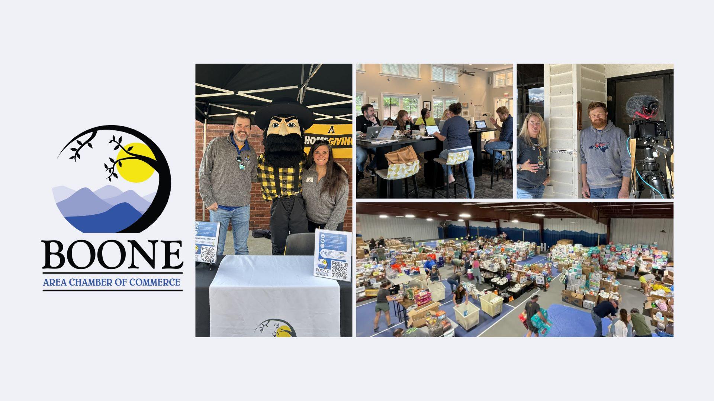

Slide 28
We Begin Again at 9:30
A film by Dr. Beth Davison, App Docs
Featuring the
community of
Todd, NC
Panelists: Kelly McCoy Renata Dos Santos

Slide 29
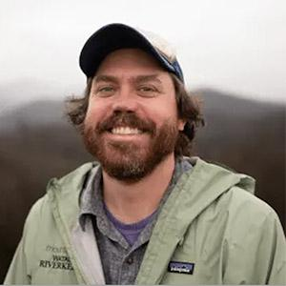
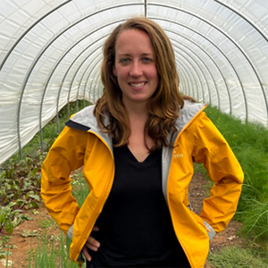
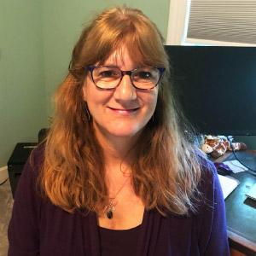
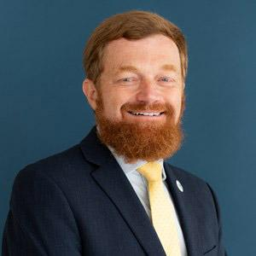
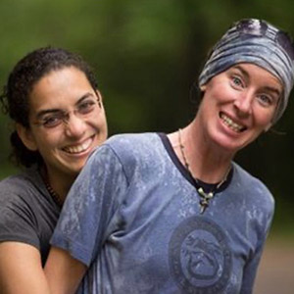
Conversation with our panel
ANDY HILL
Watauga
Riverkeeper / Mountain True
LIZ WHITEMAN
Blue Ridge Women in Agriculture
KELLIE REED ASHCRAFT
Watauga Housing Council
DAVID JACKSON
Boone Area Chamber of Commerce
KELLY MCCOY & RENATA DOS SANTOS
RiverGirl Fishing Company

Slide 30
Mark your calendars:
Saturday, February 22
Appalachian Theatre
2:00 Boone Docs Juried Films about the Appalachian Region
7:00 Features the documentary work of local filmmakers sponsored by High Country Humanities
hchumanities.appstate.edu

Slide 31
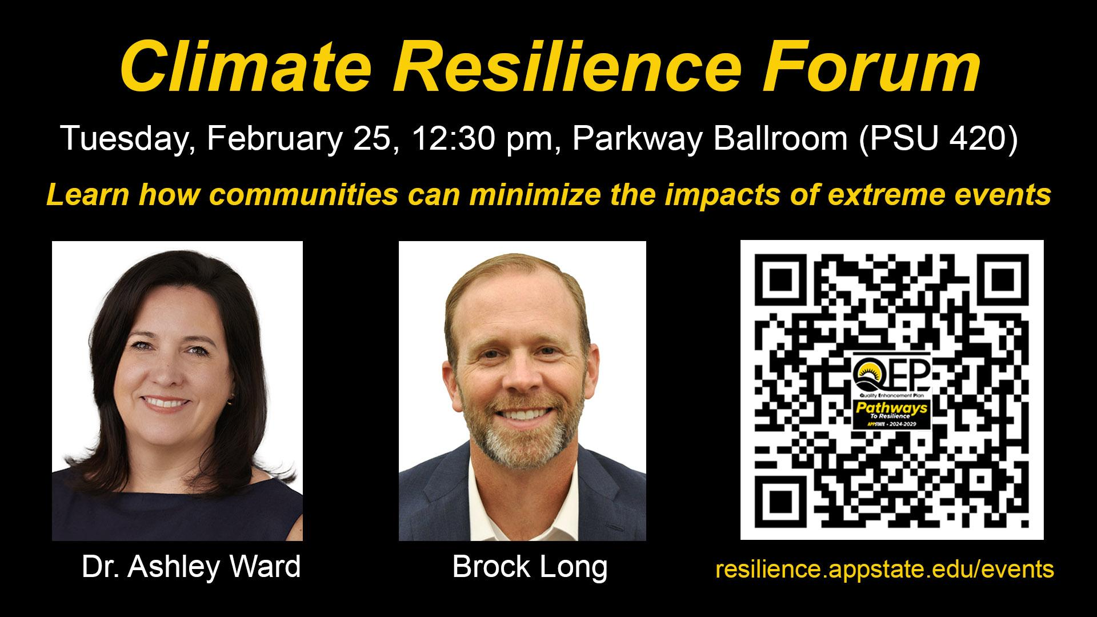

Slide 32
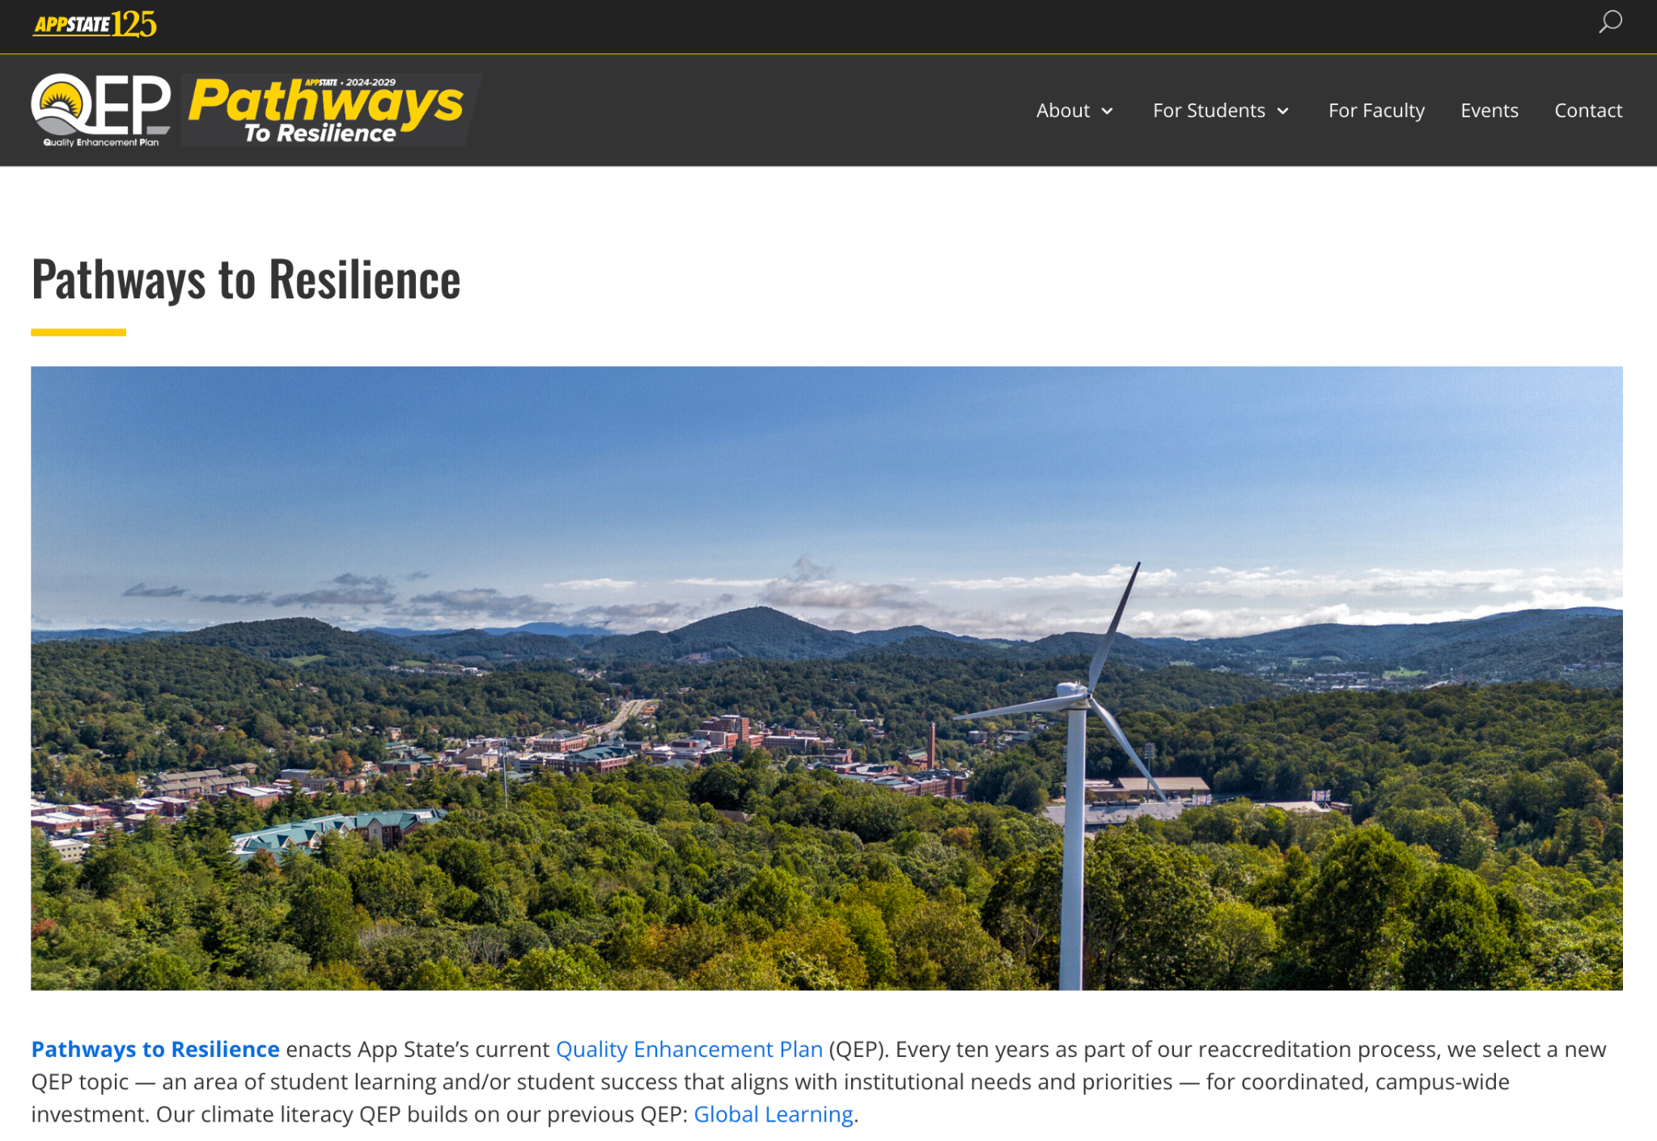
resilience.appstate.edu

